Slide 2
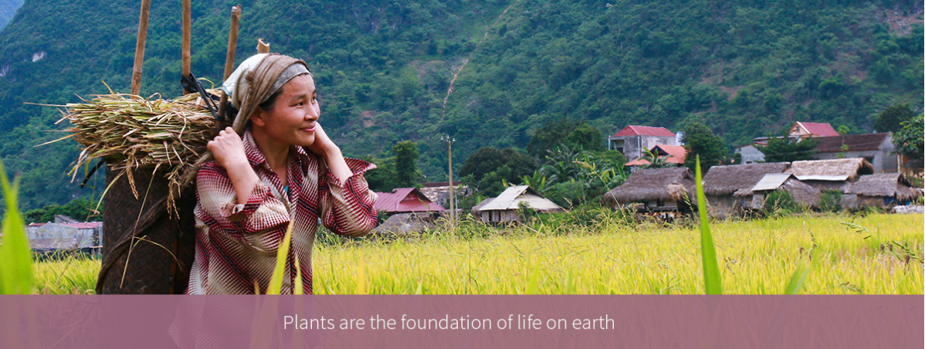
IYPH main objective
"The International Year of Plant Health will raise awareness of the importance and impacts of plant health in addressing issues of global importance, including hunger, poverty, threats to the environment and economic development"
Notes:
Specific objectives (approved as the main objective by the CPM):
Raising the awareness of the public and political decision makers at the global, regional and national levels about plant health
Promoting a strengthening of national, regional and global plant health efforts and their resources in light of increasing trade and new pest risks caused through climate change.
Educating the public and increasing its knowledge about plant health.
Enhancing dialogue and stakeholder involvement in plant health
Increasing information about the state of plant protection in the world
Facilitating the establishment of plant health partnerships on national, regional and global levels

Slide 3
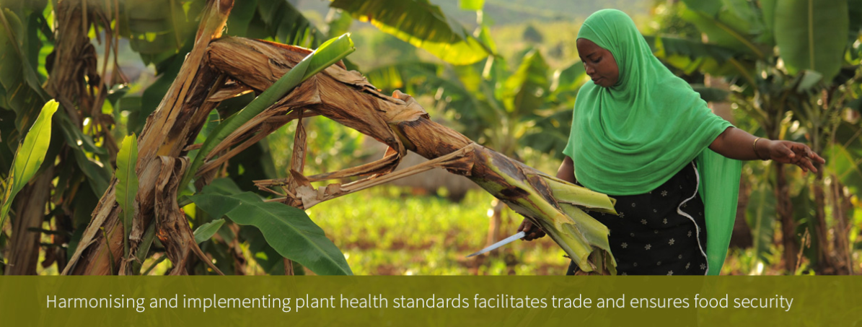
Concept of Plant Health
For the purpose of the IYPH 2020:
“Plant health is usually considered the discipline that uses a range of measures to control and prevent pests, weeds and disease causing organisms to spread into new areas, especially through human interaction such as international trade”
Notes:
As adopted by CPM-11 (2016): https://www.ippc.int/static/media/files/publication/en/2016/07/Report_CPM-11_2016-07-19_withISPMs-revised.pdf

Slide 4
IYPH proclamation background



CPM 2015
FAO Conference 2017
FAO COAG + Council 2016
Notes:
2015-03: Finland proposed the establishment of an International Year of Plant Health – CPM-10 approved the proposal.
2016-04: CPM-11 adopted the scope and objectives for the IYPH and established internal Steering Committee.
2016-09: The 25th Session of the FAO Committee of Agriculture (COAG) approved proposal by Finland to hold IYPH.
2016-12: The 155th Session of the FAO Council approved the IYPH draft resolution and forwarded it to the FAO Conference for adoption.
2017-04: CPM-12 approved the anticipated outputs and outcomes for the IYPH.
2017-07: The 40th Session of the FAO Conference approved IYPH resolution.

Slide 5
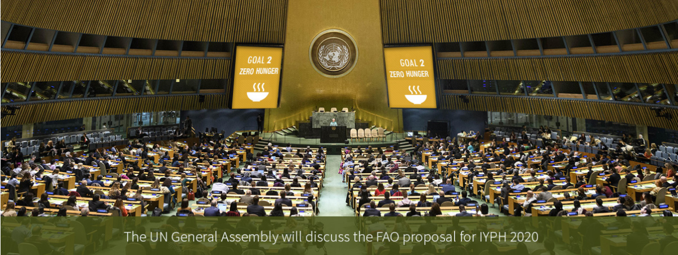
Towards the IYPH proclamation
2018-04: CPM-13 agreed to the skeleton of IYPH programme events and their associated estimated costs proposed by the IYPH StC.
2018 (ongoing): All countries are invited to contact their UN Missions to support the IYPH resolution.
2018-11: Finland and other UN members are expected to present a resolution to proclaim IYPH 2020 at the UNGA 2nd Committee.
Notes:
-IYPH StC: Steering Committee of the International Year of Plant Health established by CPM.
-United Nations General Assembly second committee – dealing with Agriculture.
-All countries are invited to support the resolution raised by Finland.

Slide 6
Actions to support the IYPH proclamation
The IYPH StC agreed to the following:
Develop and share IYPH support letter and information package in FAO languages (IYPH and IPPC factsheets, links to plant health-related articles, model statements)
IYPH phases and associated outcomes
NPPOs are invited to do the following:
Share information package with UN Missions
Liaise with UN Missions to ensure they support the IYPH resolution (possibly as co-sponsors, not entailing financial engagements)
Secure funding for the global programme (through the IPPC trust fund), and respective regional and national programmes

Slide 7
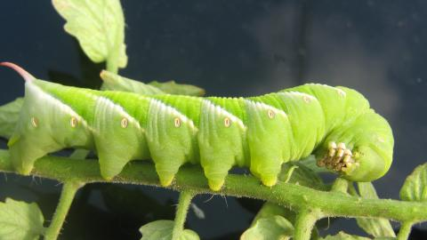
What you can do to support the proclamation?
Contact your UN Missions to support IYPH proclamation.
Coordinate with your IYPH StC representative.
Start planning national and regional activities now.
Give presentations at scientific conferences.
Involve national stakeholders including media, civil society, academia.
Look now for financing your part!
Notes:
Contact your UN Mission Representatives (through Ministries of Foreign Affairs) asking to support IYPH proclamation at UNGA.
Coordinate with and inform your IYPH StC representative / IPPC Secretariat.
Start planning national and regional activities now.
Give presentations at scientific conferences.
Involve national stakeholders including media, civil society, academia.
Look now for financing your part!

Slide 8
After the IYPH proclamation (1)
2019:
- FAO will form a new IYPH International Steering Committee.
- Current IPPC IYPH StC will be maintained under the form of technical advisory committee.
2019-12: IYPH launch events in New York and Rome.
2020: IYPH activities at the global level, including:
- Ministerial-level CPM in Rome
- International Conference on Plant Health (location TBD)
- World Food Day focused on Plant Health
- IYPH closing event in Rome
Notes:
-New FAO ISC will be composed of FAO PermReps representing the regions, FAO and IPPC Secretariat, relevant international organizations, civil society and private sector representatives, and possibly the Chair and Vice-Chair of the current IPPC IYPH StC.
-Launch events: in New York (to involve the media and decision makers, including an exhibit and media corner, possibly with opening by the UN Secretary-General, the FAO Director-General and a global ambassador) and at FAO HQs in Rome (including an opening ceremony and a seminar to deep into the themes and involve academics, scientists, experts).
-Ministerial-level CPM during CPM, not replacing the CPM, with Ministers attending for one or two days to approve strategic issues (probably March/April 2020).
-International Conference may be in the second half of the year.
-World Food Day: 16 October 2020.
-IYPH closing event: December 2020 or January 2021 in Rome, presenting highlights from different regions and the legacy of the year.

Slide 9
After the IYPH proclamation (2)
Regional activities:
FAO Regional Conferences (proposed booths / side sessions).
Regional activities are encouraged under the FAO/IPPC coordination, regions are encouraged to report on them using the IYPH visual identity.
Coordination mechanisms to celebrate IYPH may be established at the regional level.
National activities:
National activities are encouraged under the FAO/IPPC coordination, countries are encouraged to report on them using the IYPH visual identity.
Countries may create national IYPH steering committees to coordinate relevant activities.
Notes:
-IYPH StC proposed to have booths at FAO Regional Conferences in 2020.
-Ideas on themes for the

Slide 10
Questions:
1. What have you done?
2. What are you planning to do?
… to make the IYPH a success …
Open discussion
Notes:
-Expected outcome: list of IYPH-related activities (both done and planned ones), to be shared with the IPPC Secretariat.

Slide 11
Contacts
IPPC Secretariat
Food and Agriculture Organization of the United Nations
Viale delle Terme di Caracalla, 00153 Rome, Italy
Tel.: +39-0657054812 Email: IPPC@fao.org
Websites:
www.fao.org
www.ippc.int

