Slide 1
NPPO ESTABLISHMENT
Module 1
International Framework for the
Application of Phytosanitary Measures

Slide 2
Module 1
What will I learn?
The Agreement on the Application of Sanitary and Phytosanitary Measures (SPS)
The IPPC and international bodies involved in the implementation of sanitary and phytosanitary measures
IPPC and its relationship with other relevant international treaties

Slide 3
Background
Uruguay Round Negotiations
Focus:
Market access
Direct and indirect subsidies
Sanitary and phytosanitary (SPS) measures

Slide 4
Background
Conclusion of Uruguay Round
Governments meet to sign concluding deal in Marrakech, 1994.
Agreement on the Application of Sanitary and Phytosanitary Measures is approved.
The Agreement enters into force January 1, 1995.
WTO is established as an international organization dealing with the rules of trade between nations.

Slide 5
The World Trade Organization (WTO)
Functions
Administers WTO trade agreements
Serves as a forum for trade negotiations
Handles trade disputes
Monitors national trade policies
Provides technical assistance to developing countries
Cooperates with other international organizations

Slide 6
Why the SPS Agreement?
To establish the right to protect human, animal or plant life or health
To avoid unnecessary
barriers to trade

Slide 7
The three sisters of the SPS Agreement
International standard setting bodies
Codex Alimentarius Commission (CAC)
World Organization for Animal Health (OIE)
International Plant Protection Convention (IPPC)

Slide 8
Codex Alimentarius Commission (CAC)
Sets standards, guidelines and recommendations for food safety
Food additives
Veterinary drugs and pesticide residues
Contaminants
Methods of analysis and sampling
Codes of hygiene practices

Slide 9
World Organization for Animal Health (OIE)
Sets international standards, guidelines and recommendations for animal health
Informs governments of occurrence and control of animal diseases worldwide
Coordinates studies on surveillance and control of animal diseases
Facilitates trade in animals and animal products

Slide 10
The International Plant
Protection Convention
Sets international standards, guidelines and recommendations for plant health
To prevent the spread and introduction of pests of plants and plant products
To cooperate in controlling pests of plants and plant products

Slide 11
Sanitary and Phytosanitary Measures
Measures take to protect:
risks arising from additives,
contaminants, toxins or disease organisms in food, drink, feedstuff
Human or
animal health
from
Human life
from
animal-carried diseases
Animal or plant life
from
pests, diseases, disease-causing organisms
from
other damage caused by entry,
establishment or spread of pests
A country

Slide 12
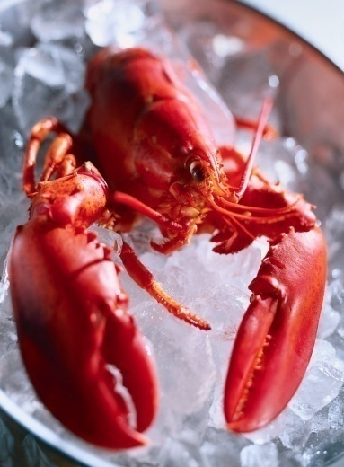
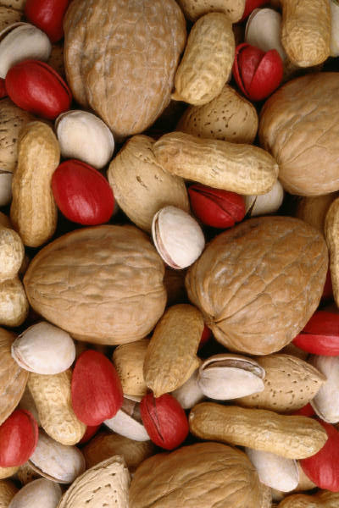
Sanitary Measures – Examples
Measures take to protect:
risks arising from additives,
contaminants, toxins or disease organisms in food, drink, feedstuff
Human or
animal health
from
Limits on residues in fish & shellfish
Limits on aflatoxin residues in nuts
Reduce risks from salmonella

Slide 13

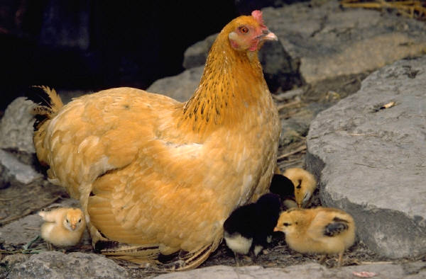
Sanitary Measures – Examples
Measures take to protect:
Human life
from
animal-carried diseases
Requirement that susceptible animals be vaccinated against rabies
Avian influenza measures

Slide 14
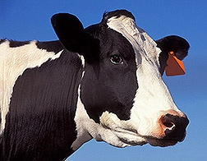

Sanitary Measures – Examples
Measures take to protect:
Plant or animal life
from
Pests and diseases
Sanitary measure to prevent introduction of FMD
Phytosanitary measure to prevent introduction of fruit flies

Slide 15
What is the IPPC?
A multilateral treaty for international cooperation in plant protection
The global instrument for the development and application of harmonized phytosanitary measures
The phytosanitary standard-setting organization named in the WTO SPS Agreement and recognized by the CBD

Slide 16
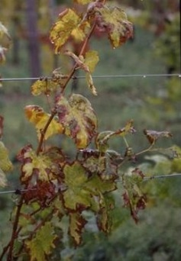
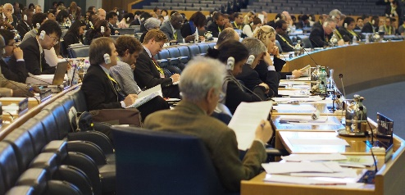

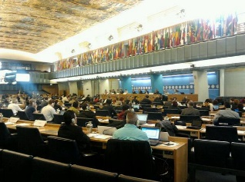
IPPC historical timeline
12 Country Agreement
Phylloxera
vastatrix
Convention
IPPC text Revised
182 Contracting Parties, RPPOs.
WTO and CBD recognized
1881
1951
1979
1997
2015
Original Text Adopted
1952 Plant Health Agreement
IPPC revised
WTO – SPS Agreement (1995)

Slide 17
IPPC revision
Revised in 1997 to align the Convention with the Agreement on the Application of Sanitary and Phytosanitary Measures

Slide 18
Revised text of the IPPC
Article 1: Purpose and Responsibility
To secure common and effective action to prevent the spread and introduction of pests of plants and plant products and to promote appropriate measures for their control, the contracting parties undertake to adopt the legislative, technical and administrative measures specified in this Convention and in supplementary agreements

Slide 19
Achieving the aims of the IPPC
Contracting parties establish National Plant Protection Organizations (NPPOs) as the sole national authorities for plant health
Regional Plant Protection Organizations (RPPOs) assist their regions to implement the IPPC and its International Standards for Phytosanitary Measures (ISPMs)

Slide 20
Principles underlying phytosanitary measures
Phytosanitary measures should
Not be trade barriers in disguise
Not discriminate among trading partners
Be harmonized and based on science
Be submitted to a process of recognition of equivalence, if requested by the exporting country
Be established through a transparent process

Slide 21
Other international treaties
The Convention on Biological Diversity (CBD)
The CBD and IPPC share key objectives of protecting the environment and biodiversity.
Among others, Article 8(h) of the CBD requires each contracting party to “prevent the introduction of, control or eradicate those alien species which threaten ecosystems, habitats or species.”
Since most invasive species can be categorized as plant pests, the CBD reinforces governments’ responsibility to address those threats through phytosanitary legislation.

Slide 22
Other international treaties
Cartagena Protocol (CP)
Adopted in Montreal on 29 January 2000
To contribute to ensuring an adequate level of protection in the field of the safe transfer, handling and use of living modified organisms resulting from modern biotechnology that may have adverse effects on the conservation and sustainable use of biological diversity, taking also into account risks to human health, and specifically focusing on transboundary movements

Slide 23
Other international treaties
The Convention on International Trade in Endangered Species of Wild Fauna and Flora (CITES)
Aims to ensure that international trade in wild animals and plants does not threaten their survival
Cross border trade involves, for example, plants including food products, exotic leather goods, wooden musical instruments, timber and tourist curios, all of which may be regulated by the NPPO.

Slide 24
Relationships to the IPPC
Protection of endangered species
Plant protection
IPPC
CITES
CP
LMOs identified as pests
SPS
CBD
Protection of biological diversity
Trade

Slide 25
Exercise 1.1
Review the IPPC text.
Consider and discuss
What is the relationship of an NPPO to the IPPC?
To what extent is your NPPO represented at the WTO SPS Committee meetings and at the Commission on Phytosanitary Measures (CPM)?

Slide 26
Exercise 1.2
To what extent does your NPPO cooperate with OIE and CAC at the national level?
To which Regional Plant Protection Organization does your country belong?

Slide 27
Exercise 1.3
Review the text of the CDB.
Identify the areas in which your NPPO cooperates in the implementation of the CBD.
Identify the ministry or agencies in your country responsible for CBD implementation and the extent to which you cooperate with them.
List ten species of endangered plants and plant products that are regulated by CITES.

