Slide 1
Stage 1. Developing the List of topics for IPPC standards
Standard Setting Training Course 2016

Slide 2
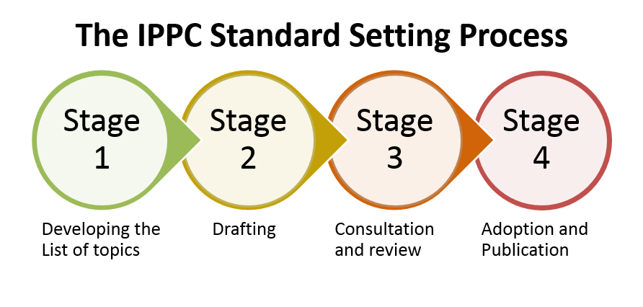

Slide 3
List of topics for IPPC standards = IPPC standard setting work programme

Slide 4
List of topics
Living document
Posted on the IPP in languages
Indicates
Topic number (tracking number)
Current title of topic
Priority
Relevant strategic objective
Drafting body
Who (SC or CPM) and year added to the List of topics
Steward(s) and assistant(s)
Approved specification number (if applicable)
Current status

Slide 5
Topics include:
Technical areas Topics
Subjects:
TPDP (protocols)
TPPT (treatments)
Call for topics
Call phytosanitary treatments (data)

Slide 6
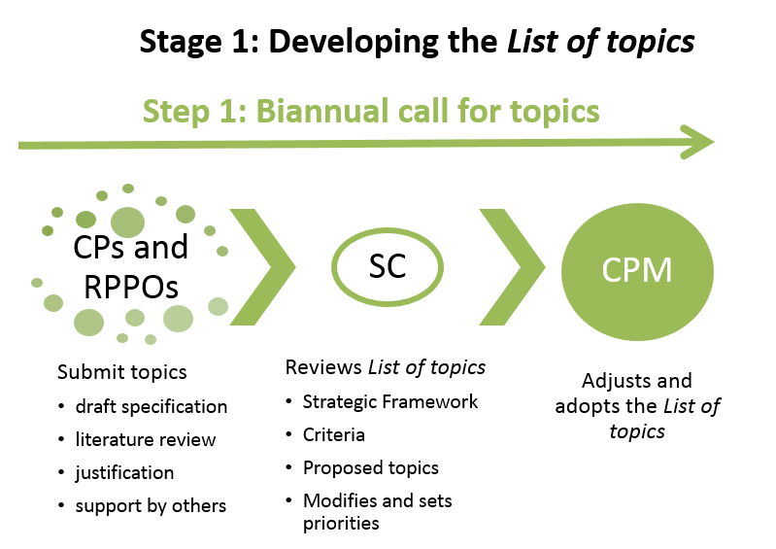

Slide 7
Biannual call for topics
Every two years (odd years)
Call for “technical area”, “topic”, “diagnostic protocol”
Does not include PTs and Glossary terms (separate call for PTs is made)
Only contracting parties (CPs) and RPPOs can submit proposals during the call for topics
Submitters are encouraged to gain support from CPs and RPPOs in other regions
Submit draft specification with proposal

Slide 8
Specifica… what?
A document giving direction to the Expert Drafting Group (EDG) for building the ISPM
Describes the scope and purpose of the ISPM
Details the tasks of the EDG and desired expertise
Technical panels also have specifications directing the work and composition
For more information: https://www.ippc.int/en/core-activities/standards-setting/development-standards/

Slide 9
Why is the specification important?
Call for the right experts
The main reference during standard development
EDG gets one 1-week meeting
needs optimal guidance to maximize focus on the right topic
Avoids waste of resources and time at all levels

Slide 10
Exercise
Where would you find the information required for the submission of a topic for a new ISPM?

Slide 11
Standards Committee reviews the List of topics and the CPM approves it
Standard Setting Training Course 2016

Slide 12
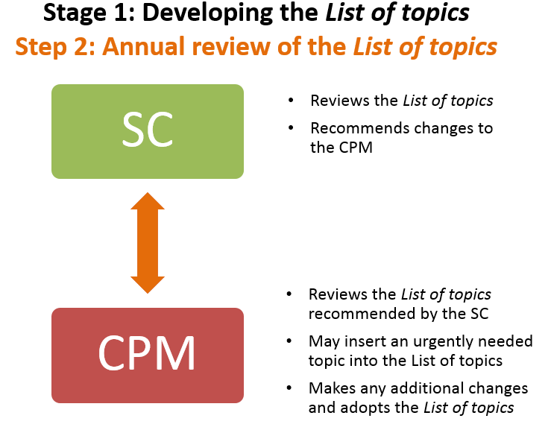

Slide 13
SC annual review and prioritization
The SC:
Reviews the existing List of topics and proposed topics
Topics are added, deleted or modified, and assigns priority
Recommends the List of topics to the CPM

Slide 14
SC annual review and prioritization (cont’d)
When reviewing, the SC refers to:
Current List of topics
Adopted ISPMs
IPPC Strategic Framework
Criteria for justification and prioritization of proposed topics

Slide 15
CPM adopts the List of topics
Reviews the List of topics recommended by the SC
Makes adjustments
Adds any urgently needed topics
Adopts the revised List of Topics
Made available on the IPP in FAO languages

Slide 16
Exercise
As an SC member, what would you think of the addition of the following topics and subjects to the List of topics?
Pest reporting
LMOs, Guidelines for living modified plants
Wheat seed and grain in international trade
Revision of ISPM 15
Citrus canker surveillance
Revision of ISPM 8
Terminology of the Montreal Protocol in relation to the IPPC
Diagnostic protocol for Conotrachelus nenuphar

Slide 17
Questions?

