Slide 1
Stage 3. Consultation and Review
Standard Setting Training Course 2016

Slide 2
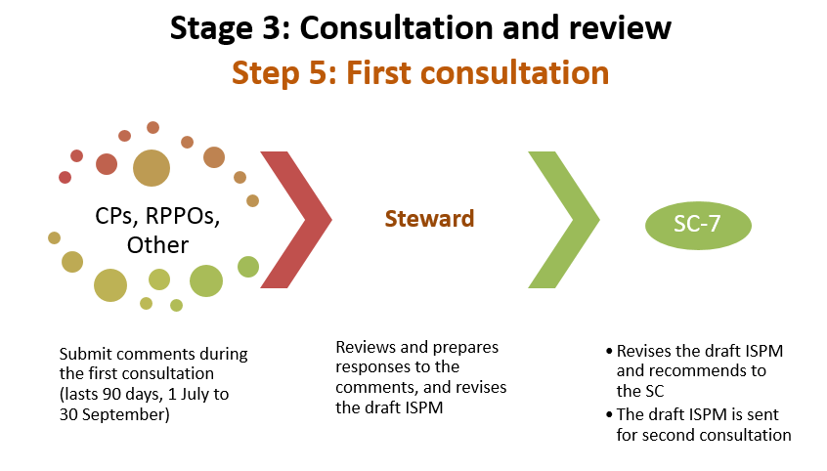

Slide 3
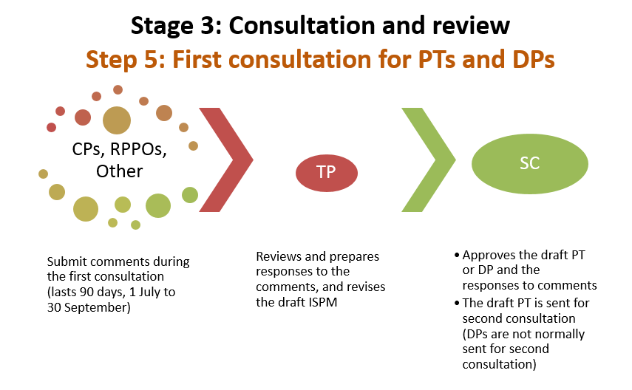

Slide 4
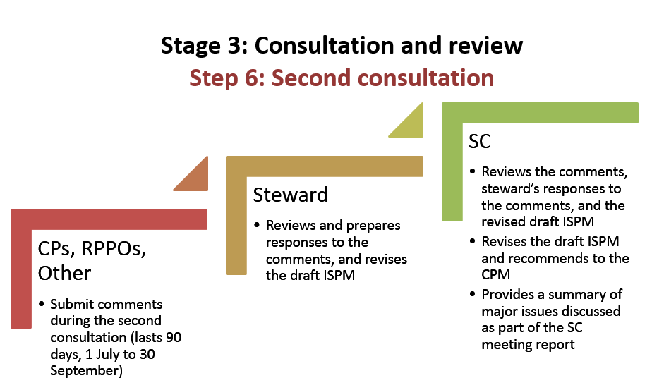

Slide 5
What is consultation?
Opportunity for contracting parties (CPs), RPPOs, relevant organizations, NPPOs of non-CPs, and other entities as decided by the SC to review and comment on draft ISPMs
Comments must be submitted by the IPPC Official Contact Point via the OCS
Lasts 90 days: July 1 to September 30

Slide 6
How are comments generated?
Collaborations and internal consultations with experts and stakeholders in your region, organization and country
IPPC Regional Workshops
Useful tools include background documents and steward’s presentation

Slide 7
What are the background documents?
Very general, provide background on the draft ISPM
Developed by the Steward
Available for Regional Workshop and to NPPOs for their consultation on draft ISPMs
Available on the IPP before consultation begins

Slide 8
Background documents (cont’d)
Overview of the content of the ISPM and how it was developed
Provides brief information on:
Development of the ISPM
What are the objectives of this ISPM
Link to relevant reports (if available)
Dates and procedures for the consultation

Slide 9
Steward’s presentations
Prepared by the Steward and the Secretariat
Brief overview of issues considered during the development of the ISPM
Support to be used by countries and regions during consultation
Available on the IPP before consultation begins

Slide 10
Steward’s presentations (cont’d)
Background
General considerations
Drafting issues
Other relevant information, such as impact on other ISPMs, elements that were excluded and why

Slide 11
Stakeholders’ involvement
What is a stakeholder?
Who are they? How are stakeholders identified?
Involvement: How to involve them, what tools?
Why consult?
Decision making
Potential challenges

Slide 12
What is a stakeholder?
Any person or group who has an interest in the project/issue or could be potentially affected by it’s delivery or outputs

Slide 13
Who are they?
National, provincial and local industry associations
Provinces and territories
Researchers
Environmental groups
Cultural groups
Cities
Other government agencies

Slide 14
How to identify them?
Usual suspects - those involved systematically in consultations
Self identifiers
Specific groups depending on the issue

Slide 15
How to involve them?
Passive and active tools for engagement
Passive tools:
List servers
Circulate draft documents
Websites
Active tools:
Conference calls, video conferences
Face-to-face meetings

Slide 16
Why consult?
Stakeholders bring a diversity of opinion, expertise and view points
Stakeholders know the most about the affected industry, environment or commodity
Not always possible for government to fully understand all facets and impacts of a new ISPM

Slide 17
Why consult? (cont’d)
Ensures that the views of all parties are taken into consideration
A better final product is developed

Slide 18
How to obtain comments?
Circulate draft documents to a list of stakeholders
Ask for further distribution to other interested people or parties
Post documents or a link on the internet for the general public

Slide 19
Involving specific groups
Reach out to stakeholders who may have a specific interest in a topic but are not on a list of regular contacts

Slide 20
Decision making – who has the final say?
NPPOs should review the comments submitted and decide which ones to submit
Some stakeholders may have their own views on the topic based on their situation and mandate, but the NPPO has a ‘global’ view and wide expertise
NPPOs should take all viewpoints into consideration when making decisions

Slide 21
Potential challenges
Comments with opposing views
The government must try to balance the good for all with the ‘harm’ caused to one industry sector
Which values are worth more: Economic or environmental?

Slide 22
Potential challenges (cont’d)
NPPOs must not only allow stakeholders to contribute, but also make sure that their contribution is taken into consideration (valued and integrated) in the resulting ISPM

Slide 23
Additional tips for successful stakeholder involvement
NPPOs can do a first "analysis" of the draft documents
Stakeholders sometimes need to be reminded why their contribution is important
Stakeholders’ involvement may take time and effort, but in the end, the result is better

Slide 24
What is a Regional Workshop?
Regional Workshops (RWs) have been held since 2001 with the initial objective of facilitating the submission of comments
Allows members within a region to discuss and prepare national comments on draft ISPMs
Cover all FAO regions except Western Europe and North America
Usually occur between mid-July and mid-September

Slide 25
Who can attend RWs?
Attendees are nominated by their IPPC Official Contact Point
All SC members of that region are encouraged to attend
Usually one IPPC Secretariat representative attends

Slide 26
How to prepare for an RW?
Review the draft ISPMs approved for consultation, and the background documents
Collaborate with experts and stakeholders in your country and region to develop comments before the RW
As directed, enter your comments in the OCS and share them with NPPOs and RPPOs that will attend

Slide 27
What happens during the RW?
All meeting participants review and discuss the draft ISPMs approved for MC
All comments are entered into OCS during the meeting
At the end of the RW, comments are shared with the NPPOs and RPPOs that attended

Slide 28
What should I do after the RW?
Contact your official IPPC Official Contact Point to let him/her know that the RW comments are available for review in the OCS
Collaborate with experts in your region, organization and country to develop and finalize comments
Ensure your IPPC Official Contact Point submits your country’s comments to the IPPC Secretariat before the end of consultation

Slide 31
What happens after my comments have been submitted?
The Secretariat compiles the comments, makes them publicly available on the IPPC and submits them to the Steward for consideration
The Steward reviews the comments, prepares responses, and revises the draft ISPM
The draft ISPM and responses to comments are made available to the SC

Slide 32
The future of RWs
RWs need to be directed by members within regions
Regions are in a better position by knowing their needs
Regions are where the expertise is
Advance planning, establishment of an organizing committee and self funding mechanisms

Slide 33
Exercise
The SC, which met in May 2016, approved several draft ISPMs for Consultation.
Could you identify these drafts?
What is the history of the development of these standards?
How would you introduce these standards?

Slide 34
Exercise
The IPPC has recently circulated a draft ISPM on International movement of cut flowers and branches for Consultation.
How would you select the stakeholders to involve?
When would you involve them?
How would you involve them?

Slide 35
SC-7 reviews the draft ISPMs
Standard Setting Training Course 2016

Slide 38
Functions of the SC-7
Examines the draft ISPMs that were revised by stewards and proposes additional revisions to the SC
Drafts SC responses to substantial member comments not incorporated into the draft
Proposes which changes should be considered further by the SC
Carries out other functions regarding draft ISPMs and specifications as directed by the SC

Slide 39
Second consultation
Once draft ISPM is recommended to the SC by SC-7 or TP:
Secretariat posts the draft ISPM for second consultation
90 days (July 1 to September 30)
Second opportunity for contracting parties (CPs), RPPOs, relevant organizations, NPPOs of non-CPs, and other entities as decided by the SC to review and comment on draft ISPMs
Comments must be submitted by the IPPC Official Contact Point via the OCS
Lasts 90 days: July 1 to September 30
Comments submitted through the OCS

Slide 40
Draft ISPM from second consultation to SC
The Steward:
Reviews comments made by contracting parties during the second consultation and prepares responses to all comments
Revises the draft ISPM and submits it, along with the responses, to the Secretariat
Responses are made available to the SC

Slide 41
At the SC meeting
The SC:
Reviews the comments and the steward’s responses
Revises draft ISPM further, if needed
The major issues discussed by the SC are recorded in the meeting report
Decides whether to:
recommend the draft ISPM to the CPM for adoption
put it on hold
return it to the steward, EWG, or TP
submit it for another consultation

Slide 42
At the SC meeting and after
If there is no major controversy and revised draft is aligned with most of the consultation comments, the draft ISPM will be recommended to CPM for adoption
If the draft goes to the CPM:
Translated into FAO languages
Posted on the IPP (at least six weeks before CPM)
subjected to objections from contracting parties no more than three weeks before CPM

Slide 43
Questions?

