Slide 2
NRO oversight body
NROAG: meeting in June 2014 → by email → dissolved by CPM-12
Representative from each FAO region: Pacific, Viliami KAMI, Tonga
Set out directions for NRO Programme:
Awareness raising → NROs UPDATE, leaflets, factsheets, NRO Years
Reminding to report → automatic reminders
Educational materials → Procedures, Guide, e-learning
Removal of IT barriers → New technology for IPP
IC (Implementation and Capacity Development Committee)
It will meet 2x Year with NROs on each Agenda
1st meeting: December 2017
Representative from each FAO region: Pacific, Ngatoko NGATOKO, Cook Islands

Slide 3
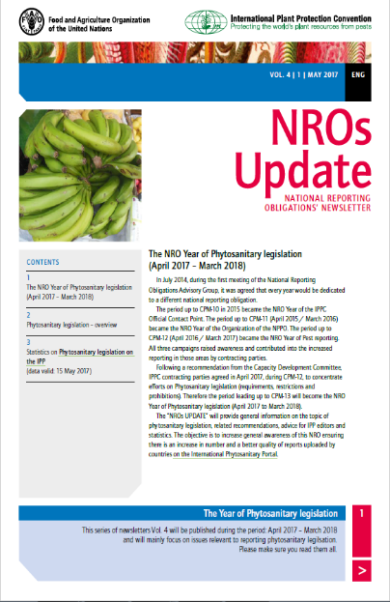
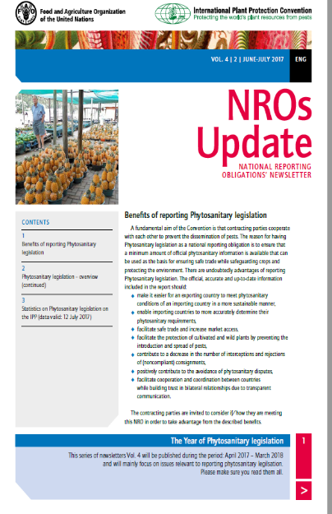
NROs UPDATE
Issued since October 2014 in 5/6 languages
Monthly, now every 2 months
NRO Year theme, statistics, advice, latest news
Sent out to CPs and editors
Uploaded on IPP

Slide 4
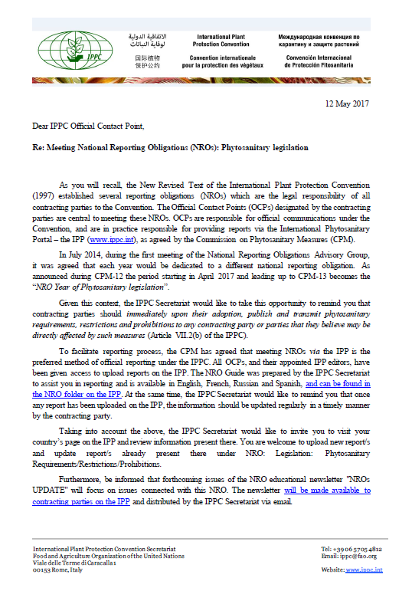
NRO Year of Phytosanitary legislation
Adopted by CPM-12 on CDC advice to align with IPPC Theme Plant Health and Trade Facilitation
April 2017 – March 2017
Official letter to CPs from the Secretary
NROs UPDATE
Statistics
Summary for CPM-13

Slide 5
NRO e-learning
5 modules:
General
Official Contact Points
Pest reporting (basics)
Pest reporting (editing)
Lists of pests
Text drafted & revised
Company outsourced to prepare electronic version
To be tested by 10 users
Will be available on Phytosanitary.info website (next to PRA course) + version on cd/stick

Slide 6
NRO automatic reminders
Operational since July 2016
Sends 1 automatic email monthly to Contact Points with links

Slide 7
NRO automatic reminders
OCP or IPP editor need to log in to the IPP to confirm or revise reports
If reports are recent no reminder is sent out
In particular:
Report/s was not updated in the last 12 months (NPPO Description/Entry points/Pest lists/Legislation) or 6 months (Pest reports, Emergency action) → reminder
Pest reports: in "Draft" or "Preliminary" status and were not updated in the last 6 months or more → reminder
If there is no report - information on empty folder
Reminders on OCPs or editors details are sent out regardless

Slide 8
NRO automatic reminders:
Ideas for improvement?
To be also send to IPP editors ?
In chosen languages (English only now)?
Infor about FILES and urls (all urls instead of only broken ones): 4 times/year: too often?
Split NPPO Description/Entry points
Pest lists/Legislation ?
Frequency?
Any other?

Slide 9
Contacts
IPPC Secretariat
Food and Agriculture Organization of the United Nations
Viale delle Terme di Caracalla, 00153 Rome, Italy
Tel.: +39-0657054812 Email: IPPC@fao.org
Websites:
www.fao.org
www.ippc.org
www.phytosanitary.info

