Slide 1
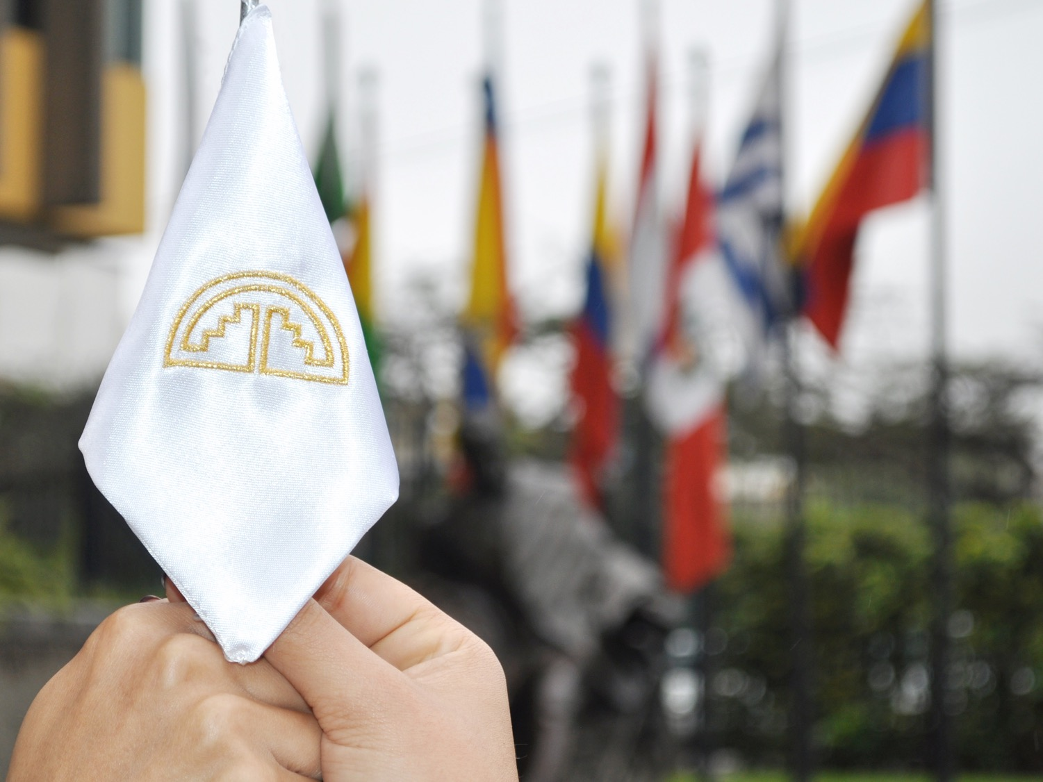

DISPUTE SETTLEMENT SYSTEM

Slide 2
Legal System in the Andean Community
ANDEAN COMMUNITY
LEGAL SYSTEM
Cartagena Agreement
Treaties and Protocols
Decisions and Resolutions
The competent bodies for administrating and settling disputes arising from the application of the legal system are:
The General Secretariat
the Andean Court Justice
Supranationality
Direct effect
Supersede national regulation
Must be applied by
all Member Countries

Slide 3
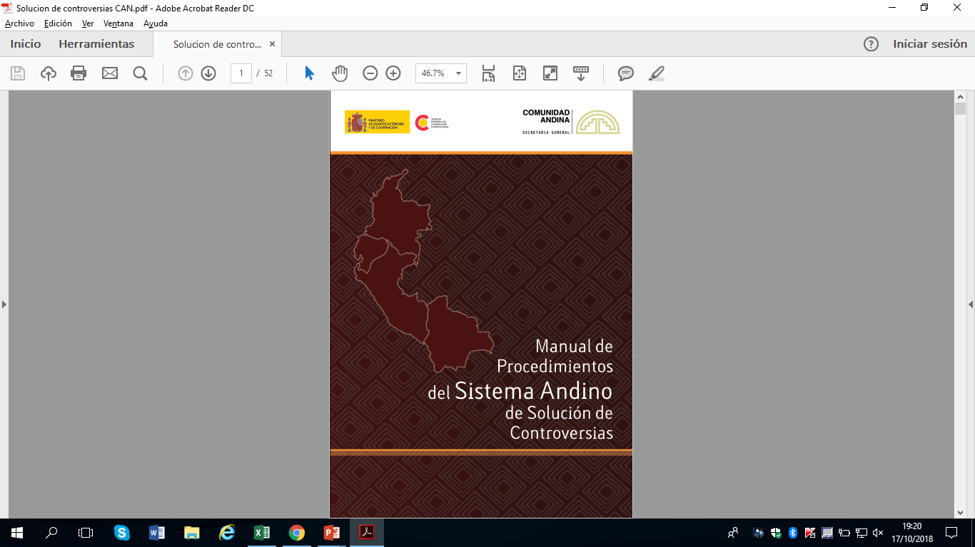
Dispute Settlement System
In the Dispute Settlement Framework the following specific proceedings can be initiated:
Dispute Settlement by the General Secretariat of the Andean Community:
  Duties or restrictions
  Non-compliance
  Dumping and subsidies
  Practices that restrict free competition
  Safeguards
Dispute Settlement by the Andean Court of Justice:
  Nullity Action
  Non-compliance
  Action due to omission or inactivity
  Labour Jurisdiction
  Prejudgment interpretation

Slide 4
Action of non-compliance
Preliminary Phase
    Action of non-compliance
Preliminary Phase
    Judicial Phase
Before
Before
    The General Secretariat
    The Andean Court of Justice
Initiated by
Initiated by
The General Secretariat, acting on its own initiative
Claims submitted by Member Countries or privates whose rights have been infringed
The General Secretariat
Lawsuits submitted by Member Countries or private whose rights have been infringed

Slide 5
Preliminary Phase: Action of non-compliance
Initiated by the General Secretariat
It is possible to have a meeting
Within 15 business days
Communication issued by the General Secretariat
Reception of the Communication by the Member Country
Response of the Member Country
Legal Opinion of the General Secretariat
Deadline for answering or for the submission of information:
No greater than 60 calendar days or less than 10 business days.
In case of flagrancy, or restriction to trade: no greater than 20 working days.
The General Secretariat indicates the Andean legal provisions that consider are not being complied by the Member Country

Slide 6
Preliminary Phase: Action of non-compliance
Initiated by Member Countries or private individuals
Within 5 business days
Within 15 business days
Within 5 business days
It is possible to have a meeting
Within 15 business days
claim submitted by MC or a private individual
Review of Claim’s requirements and Notification
The claimer rectify errors in the claim
The General Secretariat accepts or rejects the claim
Response of the Member Country
Legal opinion of the General Secretariat
Deadline for answering or for the submission of information:
No greater than 60 calendar days or less than 10 business days.
In case of flagrancy, or restriction to trade: no greater than 20 business days.
The claim has to contain the Andean legal provisions that consider are not being complied by the Member Country

Slide 7
Action of non-compliance
Judicial Phase
    Action of non-compliance
Preliminary Phase
    Judicial Phase
Before
Before
    The General Secretariat
    The Andean Court of Justice
Initiated by
Initiated by
The General Secretariat, acting on its own initiative
Claims submitted by Member Countries or privates whose rights have been infringed
The General Secretariat
Lawsuits submitted by Member Countries or privates whose rights have been infringed

Slide 8
Judicial Phase: Action of non-compliance
Initiated by the General Secretariat, Member Countries or privates
For initiating a procedure before the Andean Court, the preliminary phase has to be exhausted:
With a legal opinion (“Dictamen”) issued by the General Secretariat; or
If there is no legal opinion, 75 days after the initiation of the preliminary procedure.
Within 40 days
Within 10 days
Within
8 days
Within
60 days
Lawsuit
Ruling of Admission
Respond to the Lawsuit by the Member Country
Review of evidence
Hearing
  Final Allegation
Final Judgment
Within 15 days
Regularization of the suit, if it does not meet the admissibility requirements
The lawsuit must contain the legal arguments related to the non-compliance of the Andean Regulation

Slide 9


Secretaría General de la Comunidad Andina
Paseo de la Republica 3895, Lima 27 – Perú
Teléfono: (511) 710 6400
Fax: (511) 221 3329
www.comunidadandina.org
Thank you!
Síguenos en:
/comunidadandina
@comunidadandina

