Slide 1
Activities and result EPPO 2019 and 2020 Highlights

Slide 2
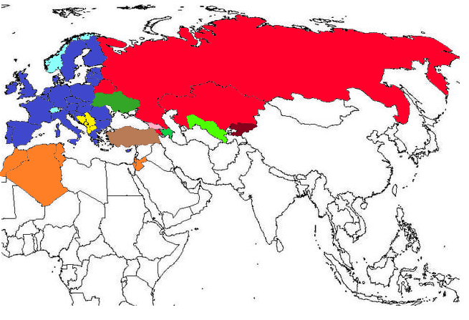
1. EPPO region: 52 member countries
European Union
Eurasian Economic Union

Slide 3
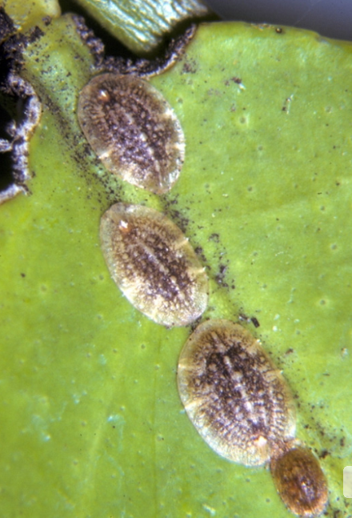
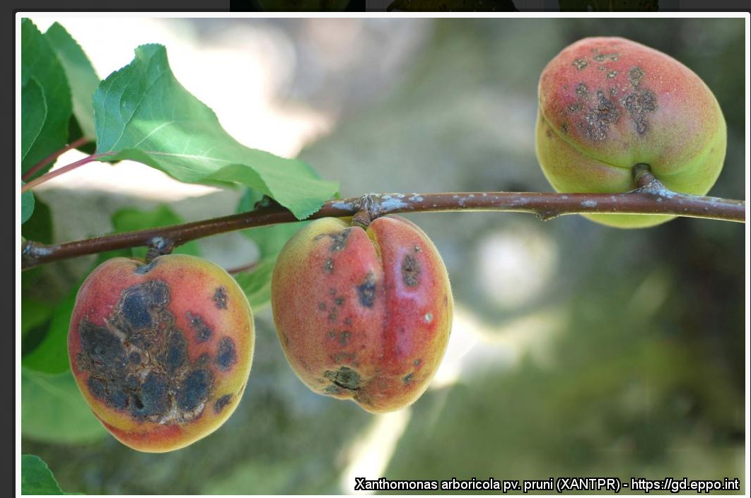
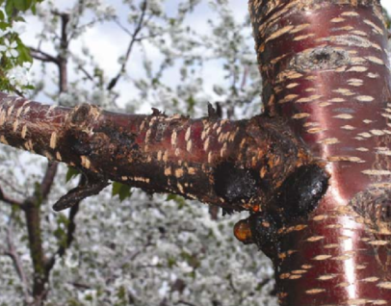
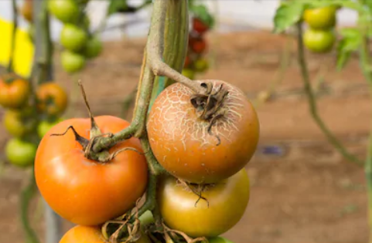
Areas of work of EPPO
- Plant Protection Product, chemical and biological (Efficacy Evaluation)
Phytosanitary Regulations
Forestry
Potatoes
Agricultural crops
Invasive Alien Plants
Biological Control Agents
Information Services
Bulletin
Reporting Service
Databases

Slide 4
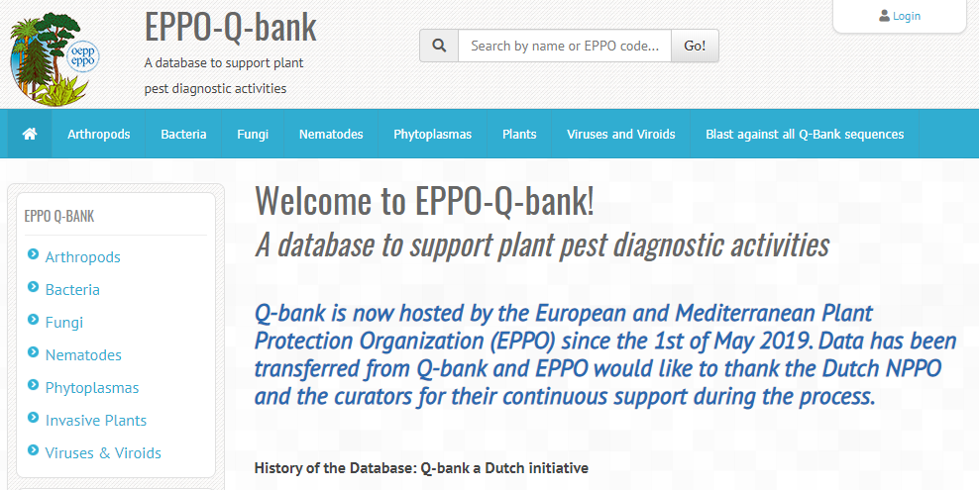
2. Some Achievements
All EPPO activities support NPPOs of member countries and have a capacity development aspect
EPPO Reporting Service
Diagnostic Protocols: X.fastidiosa, Bactrocera latifrons, Thaumatotibia
Standards on Control, inspection
PRAs, including Invasive Alien Plants
PRA training for Russian-speaking experts
Workshop Contingency Planning in Serbia (Nov 2018)
EWG ePhyto to share experience within the region
Standard on raising public awareness approved
PRA platform was established
EPPO-Q-bank launched 1st May 2019
Database Resistance to Plant Protection Products

Slide 5
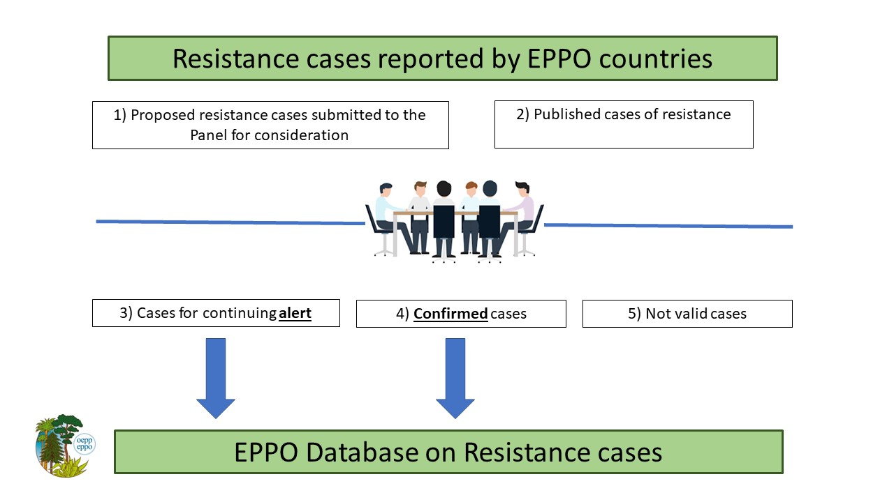
EPPO Database on Resistance Cases (in progress)
Objective: sharing information on resistance cases including published (confirmed) cases of resistance and reports of suspected resistance (emerging cases) agreed by the EPPO Resistance Panel.
Hosted by the EPPO Secretariat
- Prototype for the system validated – pilot project on-going
- Tool for the Panel, access to users beyond Panel under discussion

Slide 6
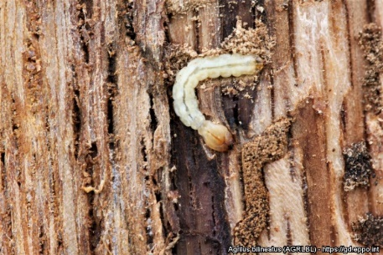
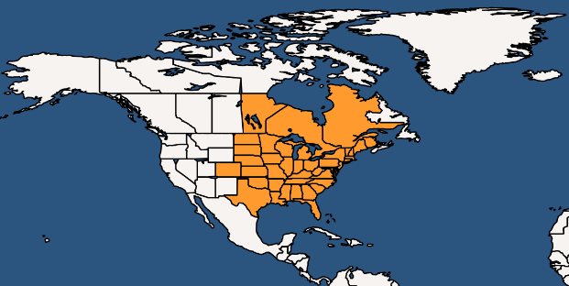
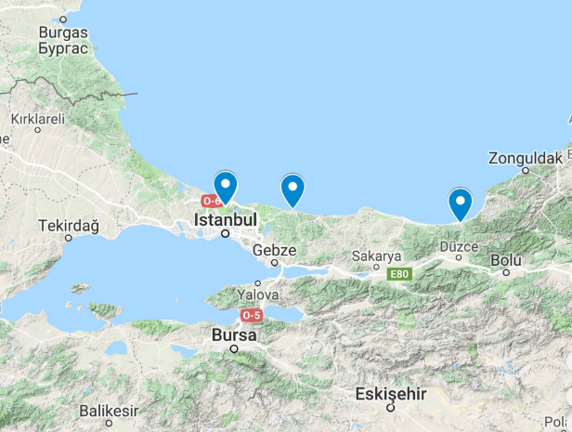
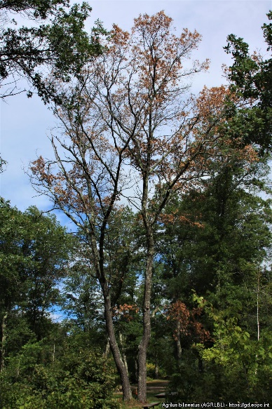
Agrilus bilineatus (Two-lined chestnut borer)
Coleoptera: Buprestidae
1 generation in 1y (or 2y)
Host plants: Oak and chestnut
Damages: Larvae feed in the cambial region, affect usage of wood, can lead to tree death in a single year
Endangered area: whole EPPO region where Quercus and Castanea are present
>200 km
2013
2016
2018
2002
Turkey
Conclusions Agrilus bilineatus A2
Canada + USA

Slide 7
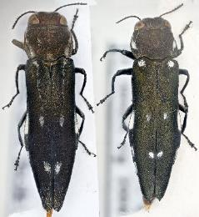
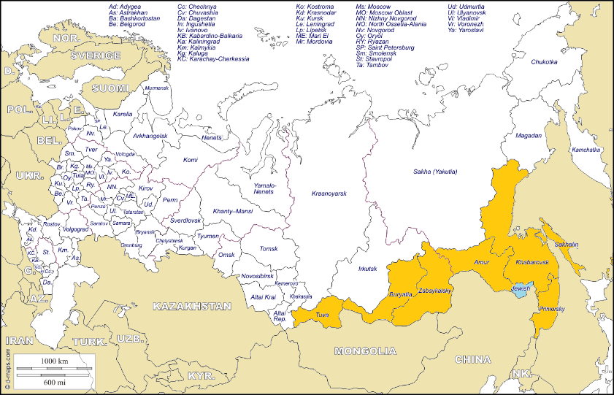
Agrilus fleischeri
Agrilus fleischeri (left side) and A. ater (right)
Conclusion A2
Coleoptera: Buprestidae
Separate species with A. ater. However, no identification key or molecular methods available
1 generation in 1y in Populus nigra var. italica, but in 2y in P. tremula var. davidiana
Host plants: Populus and Salix
Damage: Larvae feed in the cambial region, affect usage of wood, eventually lead to tree death in 2-3y (very limited information available, especially on damage potential)
Endangered area: where Populus and Salix are grown (uncertainty on host species). Climatic conditions suitable at least in the eastern part of Europe. Impact would be higher where poplar coverage is important (i.e. Russia).
Russia: south of Eastern Siberia
and south of the Far East
China, Japan, Korea Dem. Rep., Korea Rep., Mongolia, Kazakhstan, Russia

Slide 8
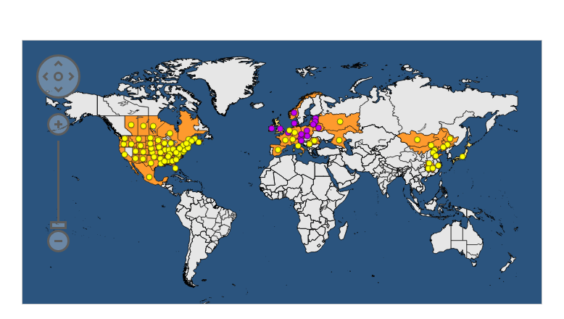
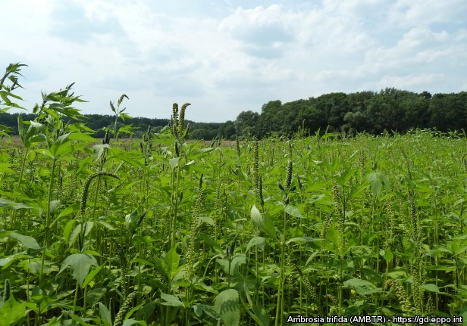
Ambrosia trifida L. giant ragweed
Native range: North America
Introduced range: Asia, Europe
Habitats: Ruderal disturbed habitats, riparian systems, field crops (annual summer crops, particularly maize, soybean and sunflower) and open habitats.
Endangered area
Predominately continental climate. Part of the Mediterranean, Steppic and Anatolian biogeographical regions also suitable. All EPPO countries south of 55º latitude have potential for establishment.
Conclusion A2

Slide 9
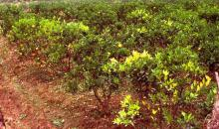
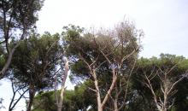
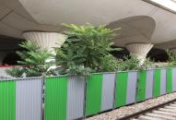
National Regulatory Control Systems (series PM9)
PM 9/NEW ‘Candidatus Liberibacter’ species that are causal agents of Huanglongbing disease of citrus and their vectors: procedures for official control
PM 9/NEW Heterobasidion irregulare: procedures for official control
PM 9/NEW Ailanthus altissima

Slide 10
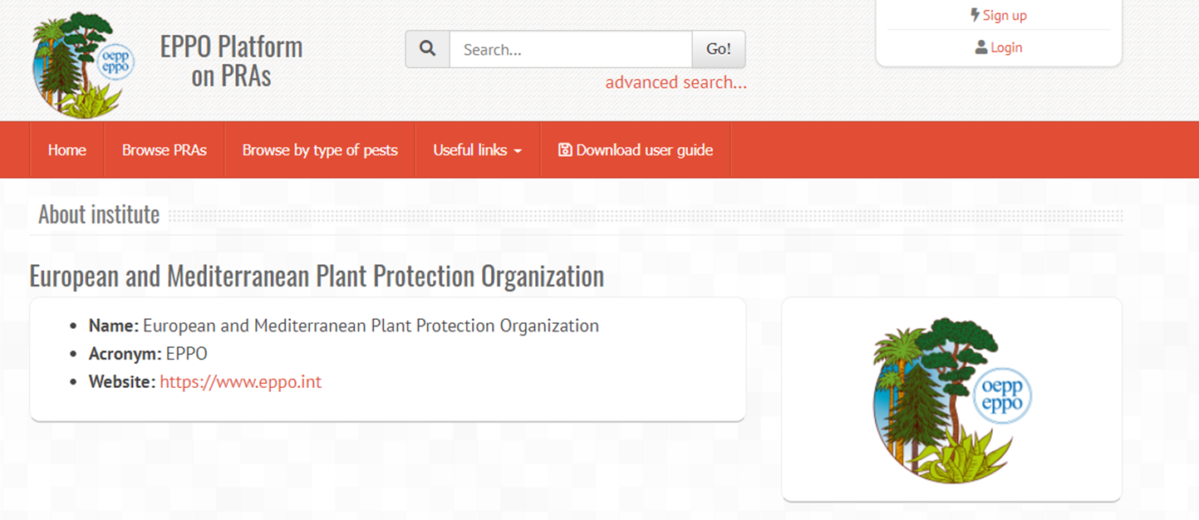
EPPO PRA platform
EPPO platform on PRA : WPPR agreed to allow non-EPPO countries to add PRAs to the platform. Condition= non-EPPO NPPOs and RPPOs are involved.
The platform will first be presented at the next Technical Consultation among RPPOs
pra.eppo.int

Slide 11
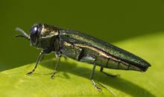
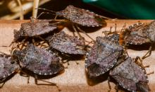
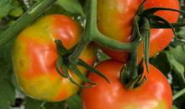
3. Emerging pests for (part of) EPPO region
Emerald Ash Borer, Agrilus planipennis (EPPO workshop in 2020)
Halyomorpha halys (Brown Marmorated Stink Bug), spreading, increasing damage, Standard on efficacy evaluation (2019)
Tomato Brown Rugose Fruit Virus (ToBRFV) PRA in 2019
Gymnandrosoma aurantianum, citrus fruit borer, PRA in 2020
Amaranthus palmeri as Invasive Alien Plant, PRA in 2020
Diagnosis of Xylella fastidiosa
Diagnosis Phyllosticta citricarpa and P. paracitricarpa

Slide 12
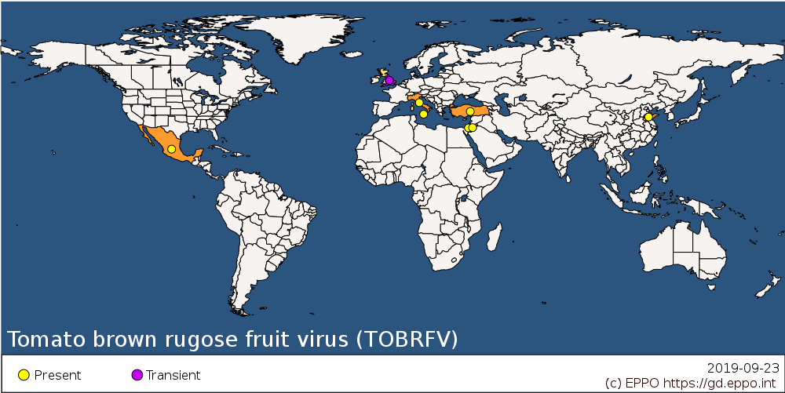
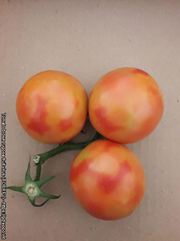
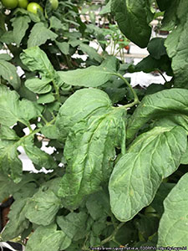
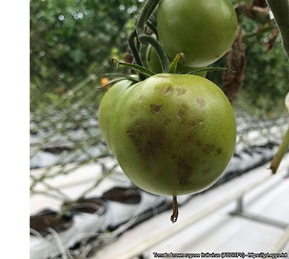
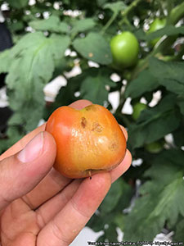
Priorities PRA: Tomato brown rugose fruit virus (Tobamovirus, ToBRFV)
First identified on tomatoes in Jordan (2015 – but symptoms in Israel in 2014), then in other EPPO countries (Germany, Italy, UK & Turkey) as well as in Mexico and China.
Main hosts: tomato and capsicum.
Level of damage vary according to countries.
Could be moved on plants for planting, seeds or by contact.

Slide 13
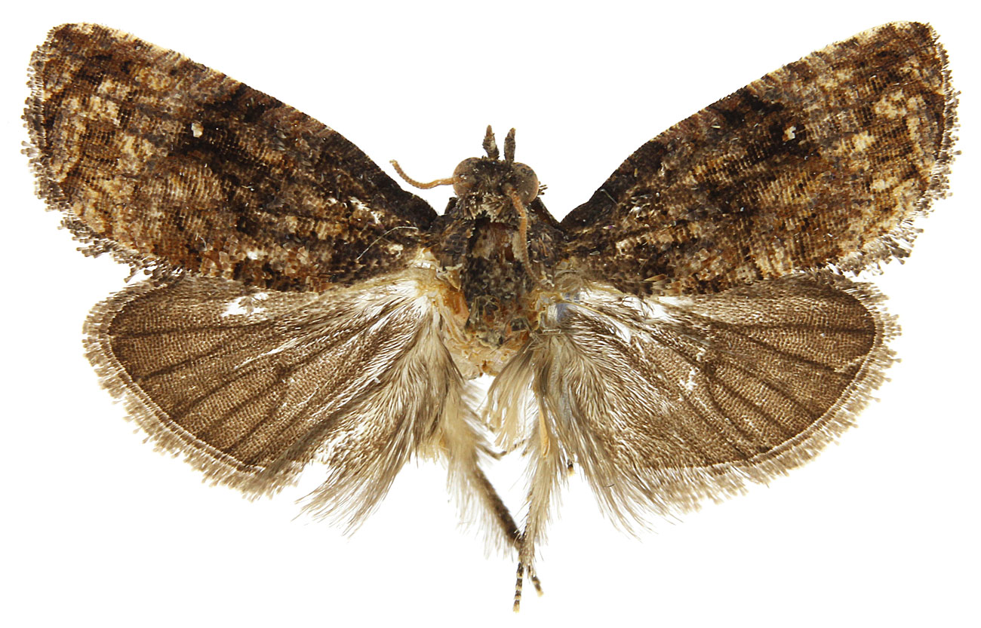
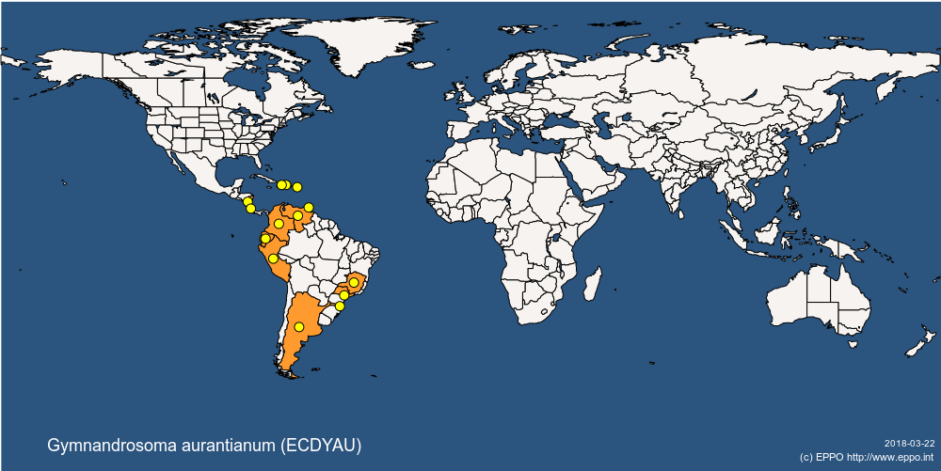
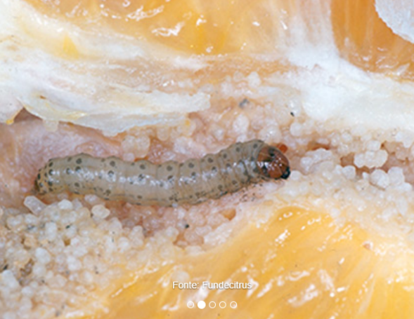
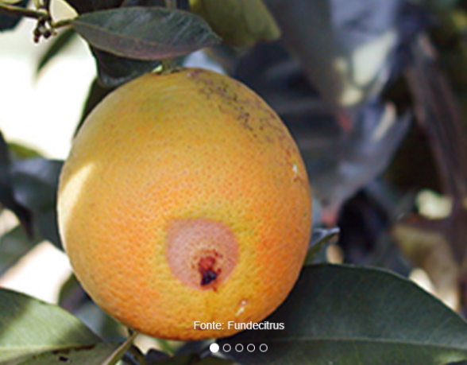
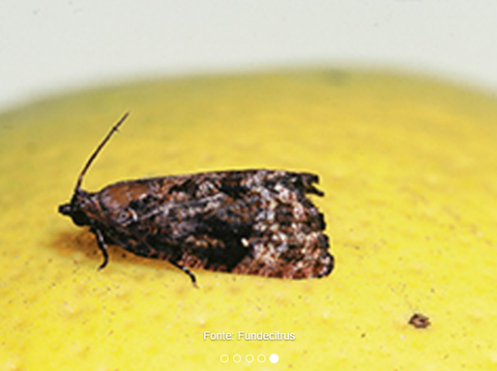
Gymnandrosoma aurantianum (Citrus fruit borer - Lepidoptera: Tortricidae)
Suggested by Spain (also identified as a potential risk by DROPSA) following several interceptions.
Pest of citrus and other fruit crops (incl. Citrus, Eriobotrya, Macadamia, Musa, Prunus persica, Punica granatum) in tropical regions of America.

Slide 14
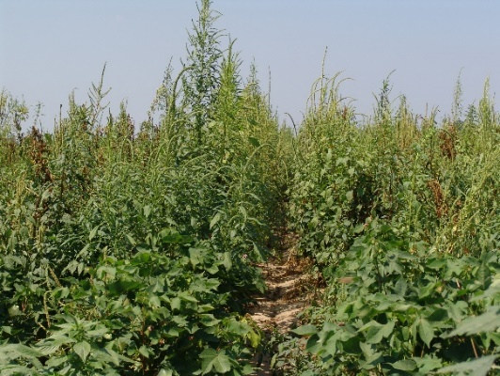
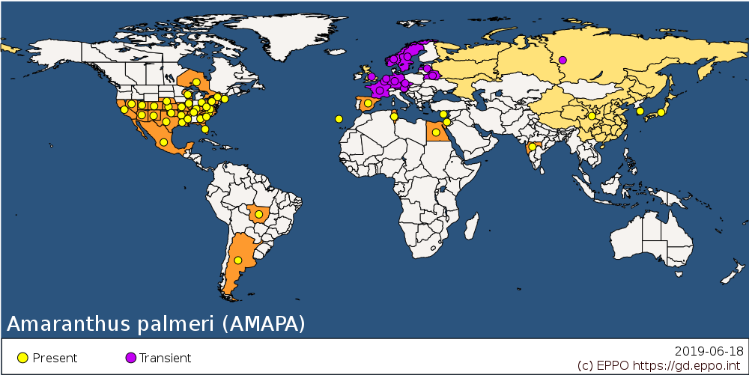
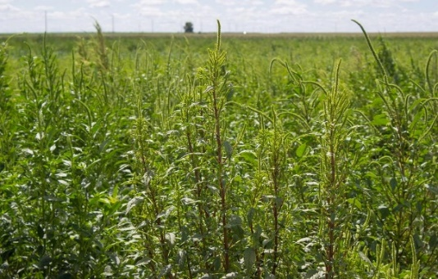
Amaranthus palmeri (Amaranthaceae)
Palmer’s Amaranth’.
Native range: North America
Introduced range: Europe (established in Cyprus, Israel, Madeira and Spain), Asia and Australia
Pathways: Contaminant of seeds and grain, machinery
Impacts: Negative impacts on agriculture (reduced yields in cotton, soybean, peanut, corn, sweet potato; increased harvesting time) & biodiversity

Slide 15
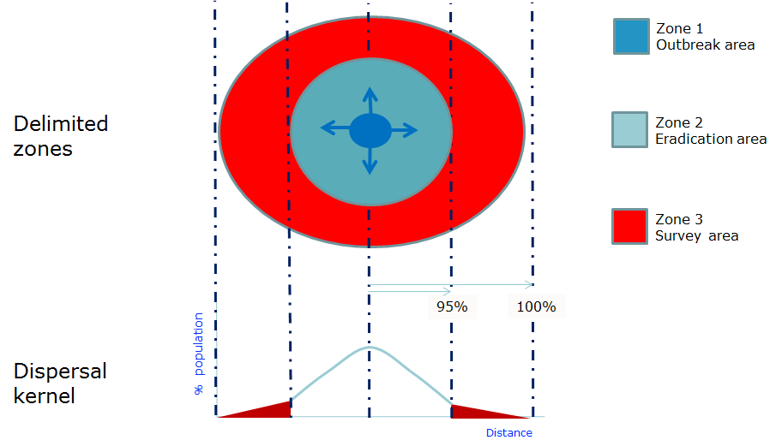
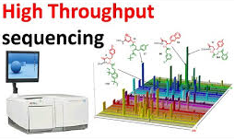
3. Emerging issues
Size of Buffer Zones (Guidance on design and implementation of Buffer Zones developed and will be tested in 2020)
High Throughput Sequencing phytosanitary conclusions from sequence data (Develop Standard in 2020)
Biological control for Invasive Alien Plants
Draft ISPM on Authorization of entities: more time needed to assess impact for NPPOs in different countries

Slide 16
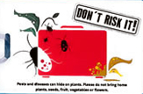
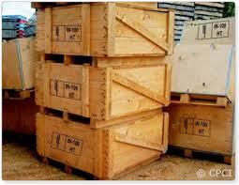
4. Surveillance, Inspection, Diagnosis
Assist NPPOs with standards and Diagnostic protocols
Emerald Ash Borer, Xylella
Implementation of ISPM 15 (regional EPPO workshop in 2020)
Inspection for IAP at import (Develop Standard in 2020)
Inspection passengers’ luggage (Develop Standard in 2020)

Slide 17
5. Future collaboration
Databases (PRA, BCAs, Diagnostic expertise, DP)
Datasheets of pests
Research coordination (Euphresco)
Pest reporting: Countries (to EU) to RPPO to IPPC
IPPC Pest Outbreak Alert and Response Systems and Global Surveillance System
Awareness raising in IYPH

