Slide 1
ISPM 12 (2010): Appendix 1
IPPC Secretariat
20 November 2012
Vittoria City, Brazil

Slide 2
Structure of Appendix 1
Provides framework for ePhyto
All the components that are available for the paper version
References all coding and codes
Electronic parameters are likely to change “often”
Modify based of field experience
Flexibility in updating through a formal and transparent manner
Do not want to have to go through the whole formal std setting process of a number of years

Slide 3
Electronic certification, information on standard XML schemas and exchange mechanisms
Introduction
XML message and XML schema
Electronic contents of the XML schema: harmonization by coding
2.1 Country names
2.2 Scientific names
2.3 Description of consignment
2.4 Treatments
2.5 Additional declarations
2.6 Further elements
Deleted [2.7 Name of authorized officer]

Slide 4
Electronic certification, information on standard XML schemas and exchange mechanisms
3. Secure Exchange Mechanisms
4. Re-export
4.1 Re-export in a full electronic system
4.2 Re-export with electronic certificate while export with paper certificate
4.3 Re-export with paper certificate while export with electronic certificate

Slide 5
Electronic certification, information on standard XML schemas and exchange mechanisms
5. The NPPO of the exporting country ‘s management of issued electronic phytosanitary certificates (replacement)
5.1 Lost certificates
5.2 Alterations to phytosanitary certificates
5.3 Cancelled shipments
5.4 Certified copy of an electronic certificate
6. Details for filling out electronic certificates

Slide 6
Referenced material
ePhyto Website - http://ephyto.ippc.int
Formats
Harmonized codes
Exchange mechanism
Criteria for usage
Broadly applicable as possible
International standard
Maintained by others
No cost

Slide 7
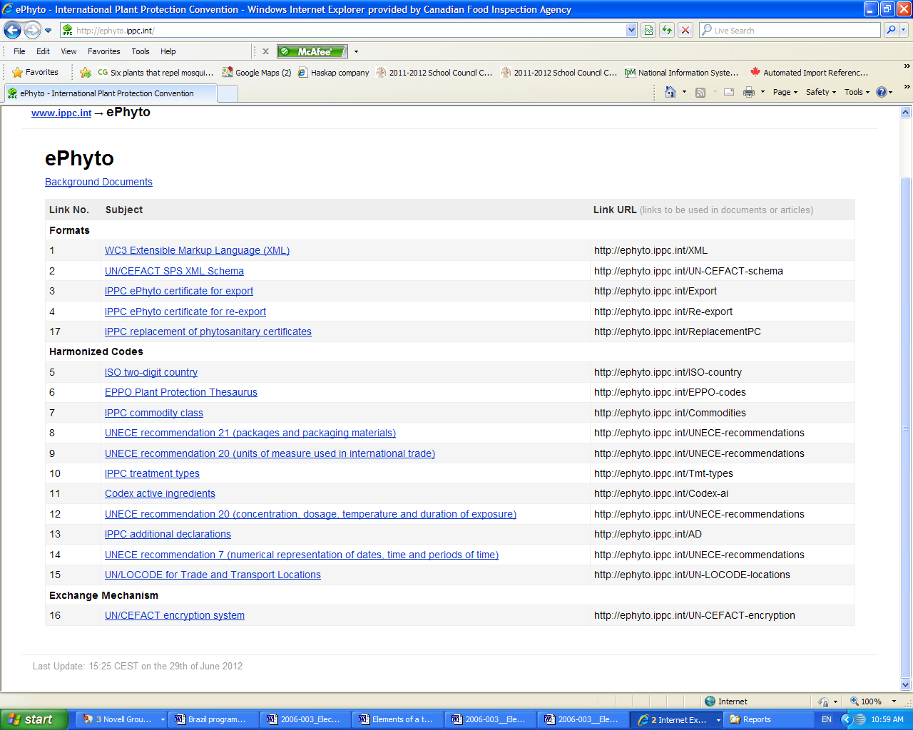
http://ephyto.ippc.int/

Slide 15
Country Comments on Appendix 1
Over 500 comments
2 months to adjust
a lot of adjustments
people still thinking in terms of paper
SC May 2013
CPM 2014

Slide 16
Contact
IPPC Secretariat
Viale delle Terme di Caracalla 1
00153 Rome, Italy
Tel: (+39) 06 5705 4812
Fax: (+39) 06 5705 4819
E-mail: ippc@fao.org
Website: www.ippc.int

