Slide 1
ePhyto – objectives of a global initiative through IPPC
Steve Ashby, UK
Chair of the Commission on Phytosanitary Measures

Slide 2
INTERNATIONAL PLANT PROTECTION CONVENTION (IPPC)
Brief history
IPPC first agreed in 1951
Revised in 1979 and 1997
1997 changes came into force in 2005
Now 177 members
14 Plenary sessions: 7 ICPMs/7 CPMs
36 Standards agreed, plus 3 Diagnostic Protocols and 14 Phytosanitary Treatments

Slide 3
Purpose (from Article 1)
Securing common and effective action to prevent the spread and introduction of pests of plants and plant products, and to promote appropriate measures for their control

Slide 4
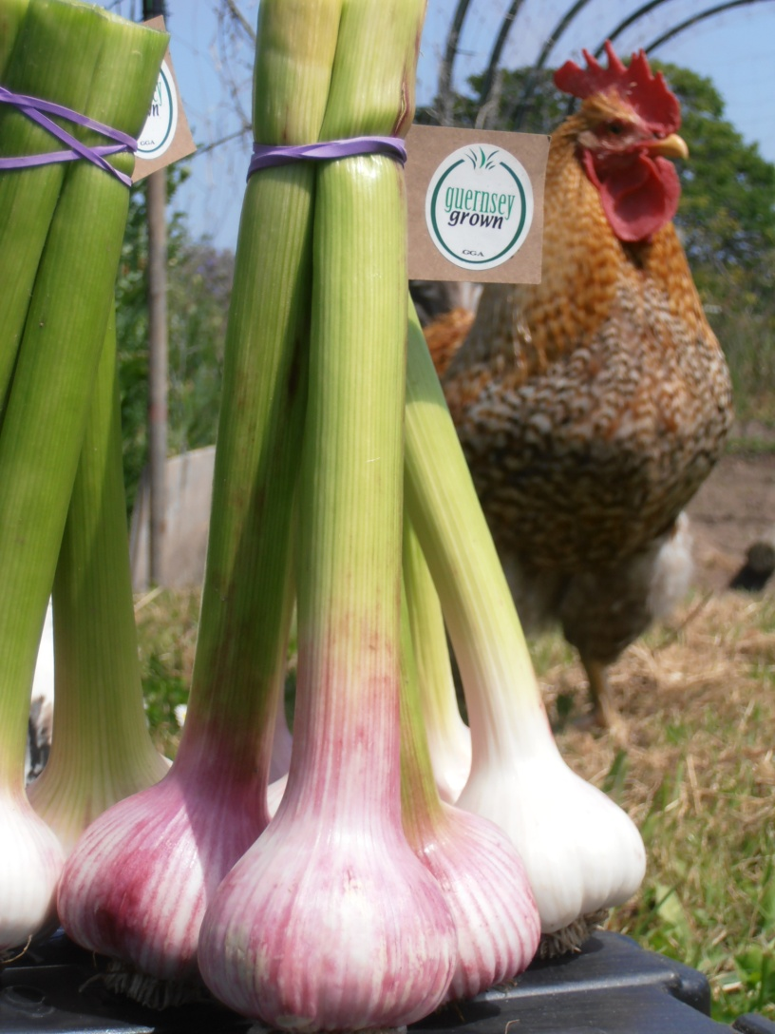
Article V – Phytosanitary Certification
V.2 second indent:
Phytosanitary certificates, or their electronic equivalent where accepted by the importing contracting party concerned, shall be as worded in the models set out in the Annex …

Slide 5
ISPM 12 Phytosanitary Certificates
The requirements and guidelines for the preparation and issuance of phytosanitary certificates
1.4 – Electronic phytosanitary certificates may be issued where accepted by the NPPO of the importing country

Slide 6
Purpose of Phytosanitary Certification
To attest that consignments of plants, plant products or other items meet the importing country’s phytosanitary import requirements
i.e. My goods don’t threaten plant health in your country, as long as you have made me aware of what risks you are concerned about

Slide 7
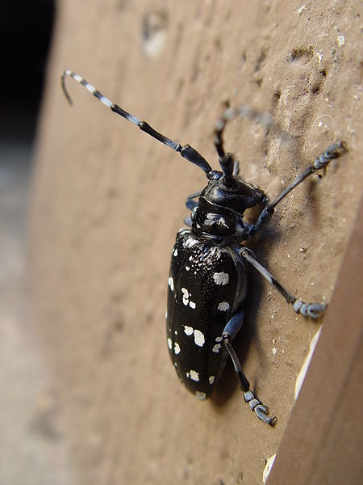
Electronic PC
Optional
NOT a new obligation
Concerns country to country
communications, not internal systems
Will be a parallel system to paper
certification unless and until
countries are
comfortable with it

Slide 8
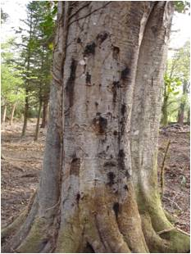
Why develop Electronic PCs?
Cuts down on exchange of paper certificates
Increase in speed
Consistent handling of all the data
Reduces risk of fraud
Integration with Customs systems

Slide 9
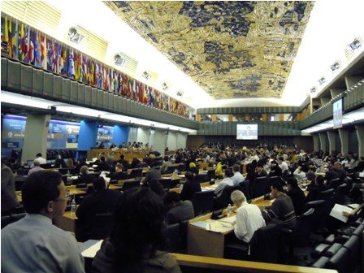
Why is IPPC involved?
Global forum for plant health issues
Some countries are moving this way, so we need a harmonised system
CPM priority
Helps ensure developing countries are involved

Slide 10
Challenges
COST – including cost/benefit assessment
Limited resources in IPPC to coordinate the work
Technological requirements
Possible need for thousands of bilateral agreements
Raising awareness and understanding

Slide 11
Meeting the challenges
Trial systems – “early adopters” - will show the way and reduce costs and raise understanding for the majority
“Global hub” could provide a readily accessible system, providing some of the technological requirements & cutting out bilateral agreements

Slide 12
What can CPM members do?
Develop their awareness
Participate in workshops
Raise colleagues’ awareness
Discuss with their IT providers
Discuss with their inspectors
Discuss with main trade partners
Seek necessary resources
“Invest to save?”

Slide 13
Objectives
A harmonised electronic certification system
Affordable for all participants
Can be operated by all participants
A system that improves the safety of trade in plants and plant products

