Slide 1
Terminology work
ISO 704:2009
Principles and methods

Slide 2

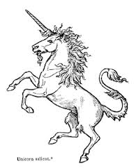
Objects
Anything that can be perceived or conceived:
Material
Abstract
Imaginary
Biology

Slide 3
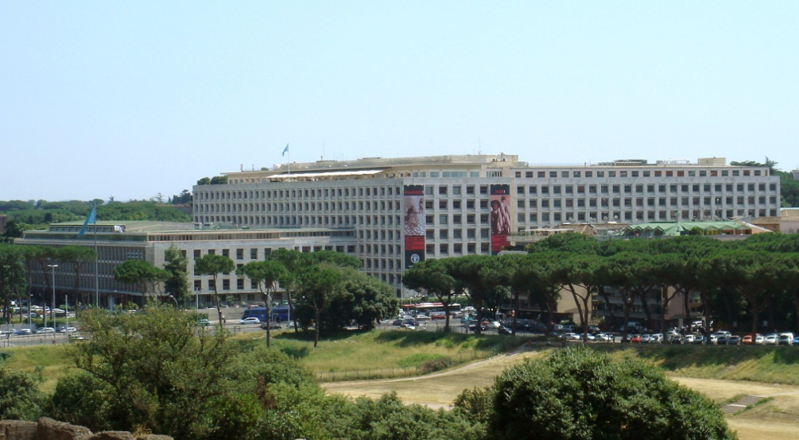

Through observation and a process of abstraction (conceptualization), objects are categorized into classes called “concepts”. An example:
FAO
Food and Agriculture Organization of the United Nations

Slide 4
Concepts
The classes of objects called concepts have common properties = “characteristics” of the concept.
The characteristics of the concept should be used in the formulation of its definition.
A set of characteristics that form a concept is called intension of the concept.
The set of objects conceptualized as a concept is known as extension of the concept.

Slide 5

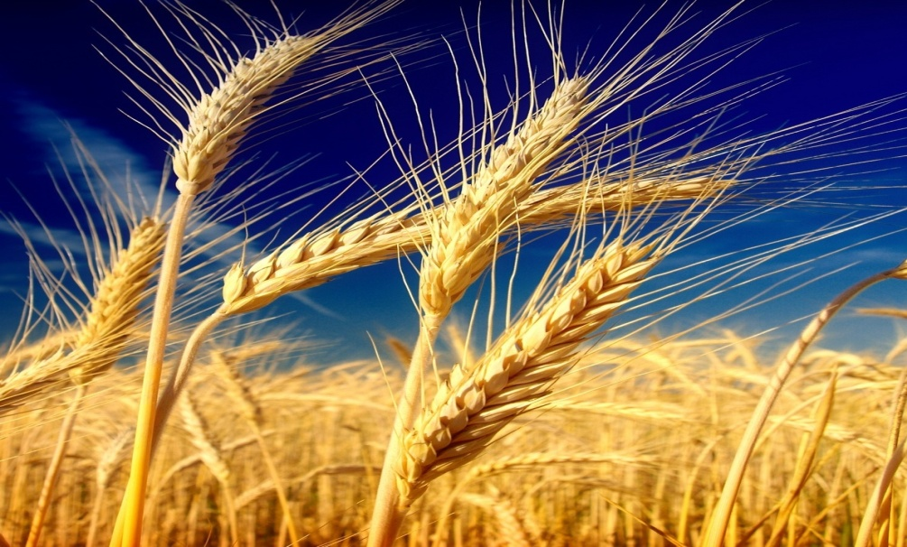
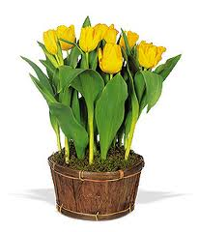
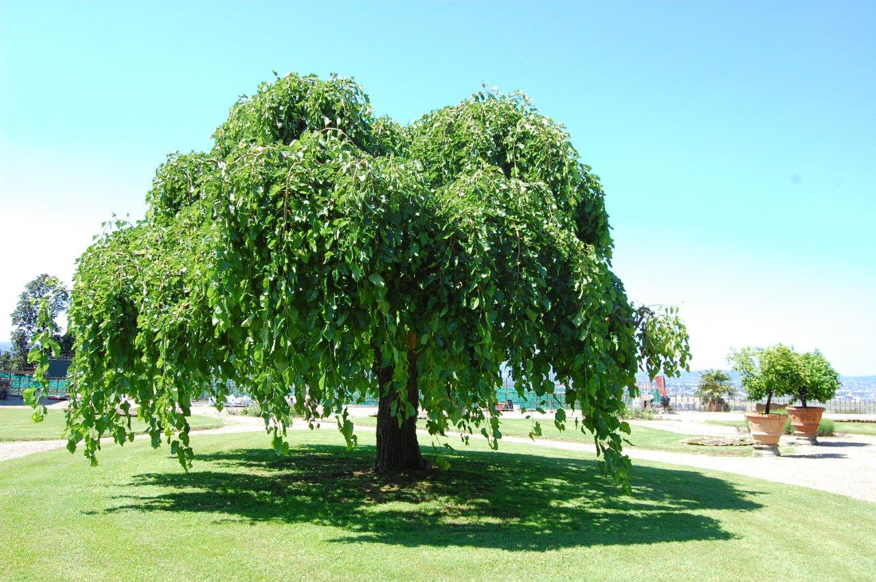
Example of extension: “plant”

Slide 6
Concept relations
A set of concepts with the relations among them form a concept system.
Similarities and delimiting characteristics.
Other possible relations among concepts :
  Hierarchical
  Ex.:Fumigation - treatment
  Generic
  Ex.:Contaminating pest – country of origin
  Partitive
  Ex.:Bark - trunk
  Associative
  Ex.:Growing season - plant

Slide 7
Concept systems
Coherent concept systems serve to:
Model concepts
Clarify relations between concepts
Standardize terminology
Facilitate comparative analysis
Facilitate the writing of definitions

Slide 8
Definitions
A definition allows to describe a concept and its relations within a concept system. It reflects the concept system
It considers the needs of the intended audience
Types of definitions: intensional, extesional, ostensive, lexical, precising, stipulative

Slide 9
Intensional definitions
Minimum amount of information (aim = enough, rather than complete understanding)
The most concise, precise and consistent
Ex.: Bark = The layer of a woody trunk, branch or root outside the cambium.
To be preferred!

Slide 10
Intensional definitions
Superordinate/subordinate concepts and the inheritance principle: for ex. plants -> trees
Limit the extension to your particular subject field (for ex. wood)
Adaptation, when the definition already exists
Describe the concept, not the words, that make up the designation-term
Describe only one concept, not its characteristics (circular definitions)
Characteristics requiring definition = separate definition!
Mention apart what is “supplementary” information

Slide 11
Supplementary information
Notes = complementary, not essential
Encyclopedic descriptions = wide range of knowledge-based information
Explanations = provides an account of how a concept operates (application) - But it doesn’t define it!
Contexts = text that contains the designation (deduction). It must be authoritative
Examples (phytosanitary measure)
( http://termportal.fao.org/faoph/search/pages/termUrl.do?id=60)

Slide 12
Extensional definitions
List of subordinate concepts
To be used only with a finite list of concepts
And/or (partitive vs. generic relationship)
Ex: threatened species = critically endangered species, endangered species or vulnerable species

Slide 13
Ostensive definitions
Also known as “demonstrative definitions”, they define by non-lexical representations of the concept (i.e. drawings, videos, graphics, etc.)
Best employed as complements
Especially useful with partitive
definitions
Ex. “exploded pie chart”

Slide 14
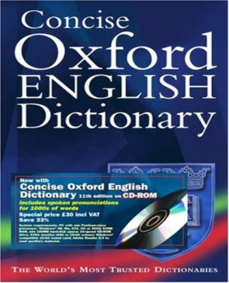
More types of definitions
Lexical definitions
They can be found in a general language dictionary
Precising definitions
When adapting a lexical definition to a specific subject field. It narrows the objects in the extension of the concept
Ex.:
Survey: An official procedure conducted over a defined period of time to determine the characteristics of a pest population or to determine which species occur in an area.
./..

Slide 15
Stipulative definitions
Specific to a unique situation (or body, or law, or publication, etc.)
They define a concept which is narrower than the one usually represented by the designation
Ex.:
For the purposes of this Act, organizations are bodies not operating for profit.

Slide 16
Be careful!
Neither too narrow nor
too b r o a d
Change of extension = new concept
Negative definitions = no! (only when opposite of another already defined)
Do not repeat the designation in the definition!

Slide 17
Objects = anything perceived or conceived
Concepts = mental representations
Definitions = to provide enough understanding
Designations (terms, appellations or symbols)
Notes:
Objects = anything than can be perceived or conceived (material, abstract or imaginary)
Concepts = mental representations of objects in a specialized field
In terminology work: we only deal with a specialized language in a particular field of knowledge = subject field
Concepts can be represented in different ways, according to the type of language (natural or artificial) or medium

Slide 18
Types of designations
Symbols
(non-linguistic)
Terms
(general concepts)
Appellations
(individual concepts)

Slide 19
Terms
A designation consisting of one or more words representing a general concept in a special language in a specific subject field
Homonymy (plant)
Synonymy (hitch-hiker pest/contaminating pest)
Harmonization
Preferred, admitted, deprecated terms
Deprecation
Desirable -> one concept = one term

Slide 20
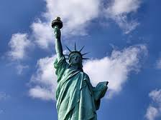
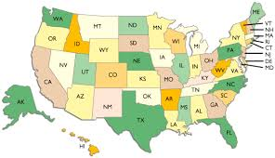
Appellations
Designates a concept whose extension is made up of a single object or multiple parts that form a single object
How to avoid the possibility of confusion (dates, place names, numbers, etc.)
Parent body (-> more arbitrary)
Time considerations: appellations change over time
They may become “terms”

Slide 21
Principles for term/appellation formation
Transparency (concept is easy to infer)
Consistency (ex. with fabrics: nylon, dacron, rayon, etc.)
Appropriateness (neutral; established patterns of meaning)
Linguistic economy (concise, otherwise omission; complex terms acceptable in scientific publications; short and long forms)
Derivability and compoundability (herb vs. medicinal plant)
Linguistic correctness (according to the norms of the language in question)
Preference for native language (individual concepts with appellations in other languages)

Slide 22
Term formation (Annex B)
Abbreviated forms in English: short forms, clipped terms (flu), abbreviations (etc.), initialisms (UN), acronyms (UNESCO)
New terms: conversion (output -> to output), terminologization (circuit), semantic transfer (screen), transdisciplinary borrowing (virus), translingual borrowing

Slide 23

Symbols
A visual representation of a concept; functions independently of any given language
Simple and easy to recognize
Unambiguous
Easy to reproduce
@
$
=

Slide 24
Contacts
Maria Elisa Rech
Ekaterina Gileva
Isabel Mendez
Zhao Yan
Bahaa ElMahdy
faoterm@fao.org

Slide 25
THE END

