Slide 1
The State Service of Ukraine on Food Safety and Consumer Protection
Department of Phytosanitary Security,
Control in Seed Production and Seedling
Directorate of Phytosanitary Security
2016

Slide 2
The history of Plant Quarantine and Plant Protection Service foundation
State Plant Quarantine Service of USSR was set up in 1931
State Plant Quarantine Service of Ukraine was set up in 1993
State Veterinary and Phytosanitary Service of Ukraine was established on 2010-12-09
State Service of Ukraine on Food Safety and Consumer Protection was established on 2014-09-10

Slide 3
Structure of the State Service of Ukraine on Food Safety and Consumer Protection

Slide 4
Structure of the Department of Phytosanitary Security,
Control in Seed Production and Seedling
Directorate of Phytosanitary Security
Directorate of Control in Seed Production and Seedling
Unit of Plant Quarantine;
Unit of Phytosanitary Measures on Border;
Unit of Plant Protection;
Sector of Risk Analysis
Unit for Supervision in Seed Production and Seedling;
Unit for Attestation, Certification and Analysis;
Sector of Control in the Field of Plant Variety Rights
Department of Phytosanitary Safety Head:
Deputy Director of the Department of
Phytosanitary Security, Control in Seed Production and Seedling - Head of Phytosanitary Security Administration - Chief State Phytosanitary Inspector of Ukraine
Mr. Andrii Chelombitko

Slide 5
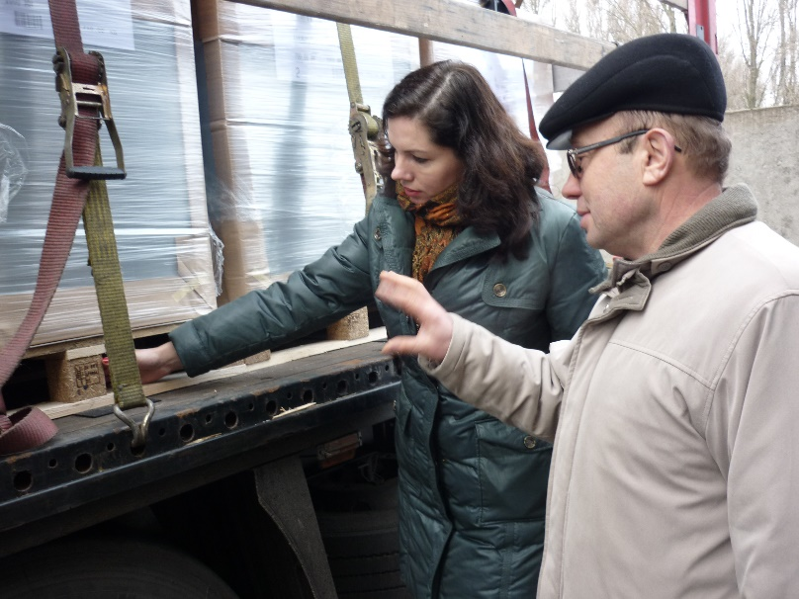
Structural offices of territorial authorities, which are responsible for implementation of the State Policy in the field of plant quarantine and protection
25 Directorates of Phytosanitary Safety in regions

Slide 6
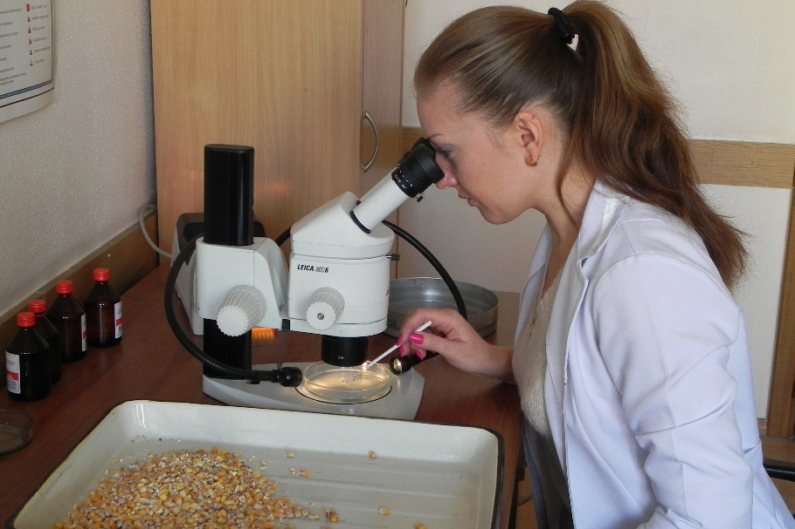
Structural offices of territorial authorities, which are responsible for implementation of the State Policy in the field of plant quarantine and protection
24 Phytosanitary Laboratories:
1 Central phytosanitary laboratory;
23 Phytosanitary laboratories are in the regions of Ukraine.
3 Other Laboratories:
2 State Border Control and toxicology laboratories (Odessa, Uzhhorod;
1 Laboratory method for biological pest control, plant diseases and weeds (Chernivtsi).

Slide 7
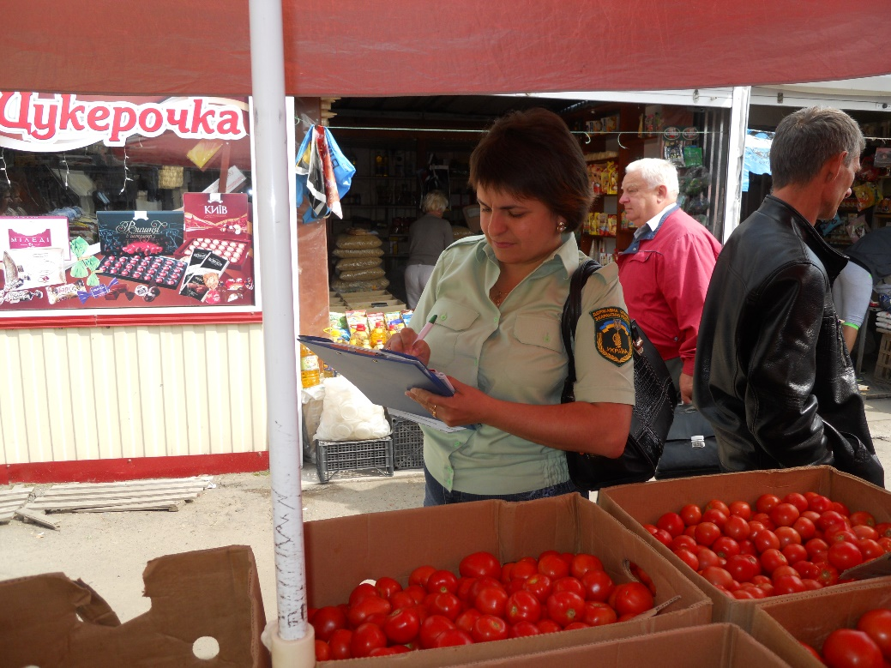
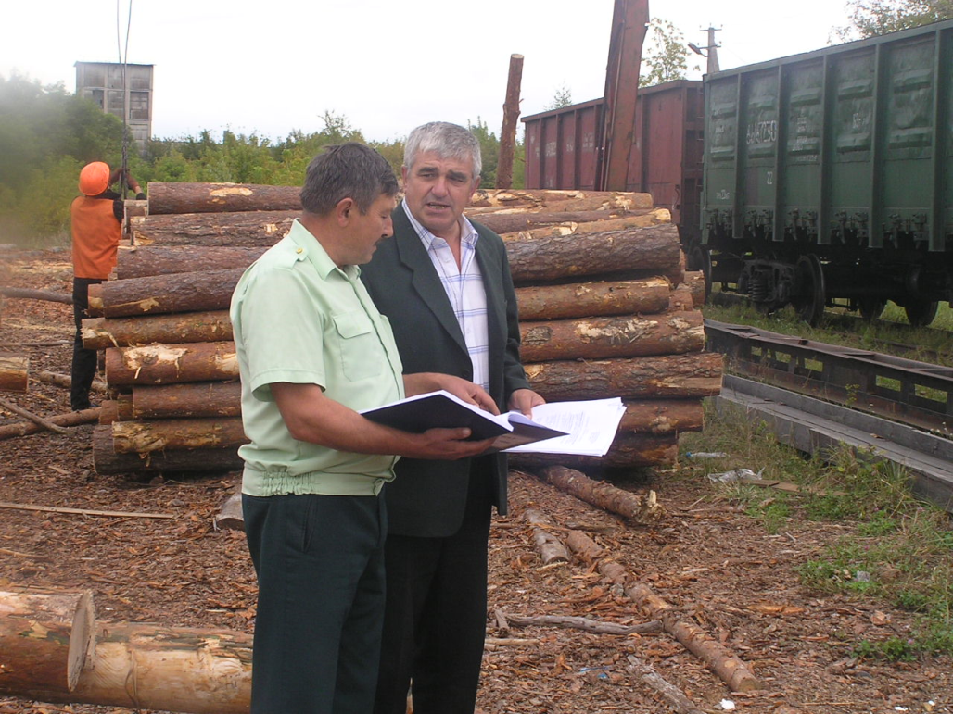
Basic principles of the State phytosanitary control
monitoring the territory of Ukraine in order to identify quarantine pests in the field of plant quarantine and protection;
sampling for analysis during cultivation, circulation, import and export;

Slide 8
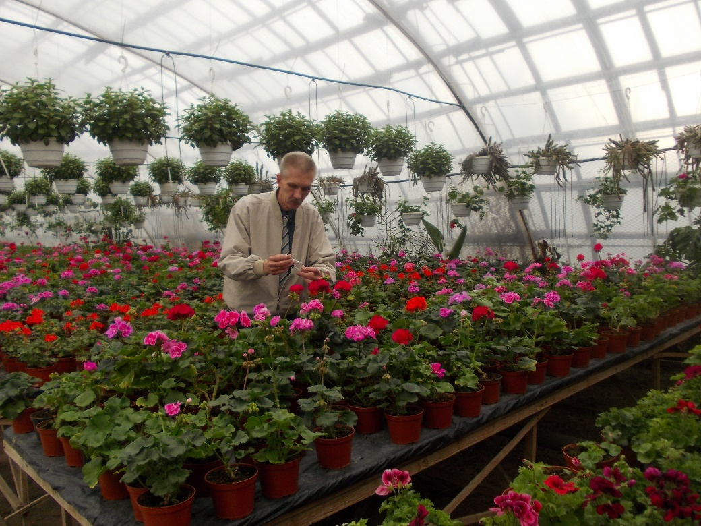
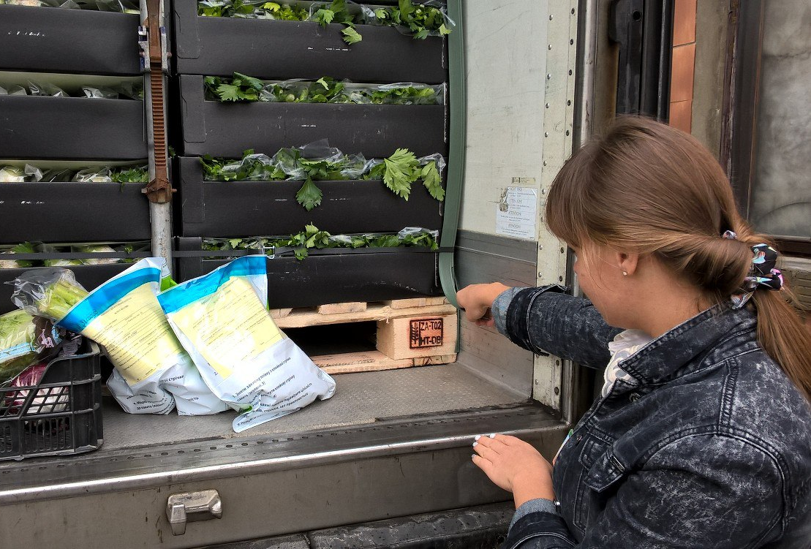
Basic principles of the State phytosanitary control
issuance of quarantine and phytosanitary certificates;
inspection of vehicles;
control over the treatment (fumigation) of infected plants and plant products;

Slide 9
Basic principles of the State phytosanitary control
Conducting the localization and liquidation of harmful and quarantine organisms;
phytosanitary expertise (laboratory tests).

Slide 10
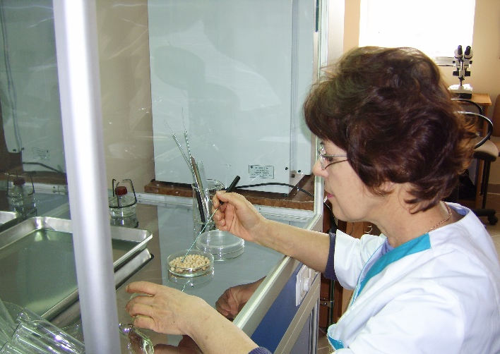
Phytosanitary laboratories
Main tendencies of phytosanitary laboratories are directed at:
Phytosanitary
expertise
timely conduction of phytosanitary expertise of controlled samples, seed and planting material samples and other production for identification of species composition of all species of regulated harmful organisms;
entomological
studying out species composition, biology and ecology of regulated pests, prognosis of their spread. Conducting of risk harmfulness analysis and decision making concerning quarantine and economic significance of detected organisms;
mycological
bacteriological
virusological
nematodological
weeds

Slide 11
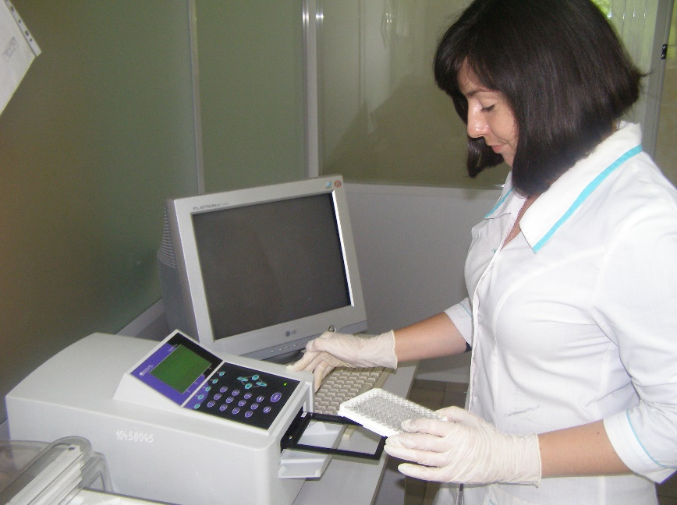
Methods of phytosanitary expertise
Morphological identification;
Isolation method;
Serological methods (IFA, IF);
Conventional and real-time polymerase chain reaction (PCR).

Slide 12
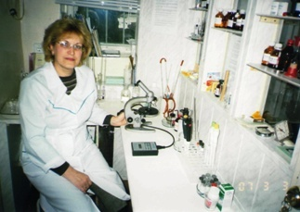
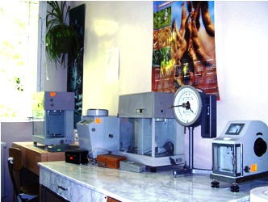
State border control and toxicology laboratories in Odessa and Uzhhorod cities
Conducting research: - Identification of the percentage of an active substance of pesticides, pesticides above the norm of term of storage; - Identification of unknown pesticides and determination their active substance; - Verification of seed dipping quality; - Determination the quality of fertilizers.
Estimation in the grain and its products: - Residual pesticides; - Toxic elements; - Mycotoxins.

Slide 13
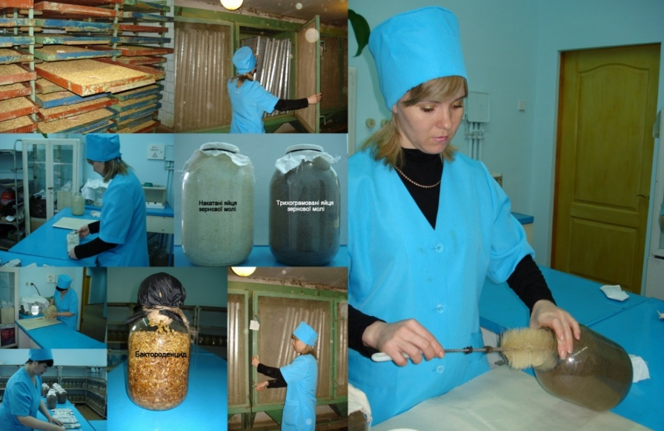
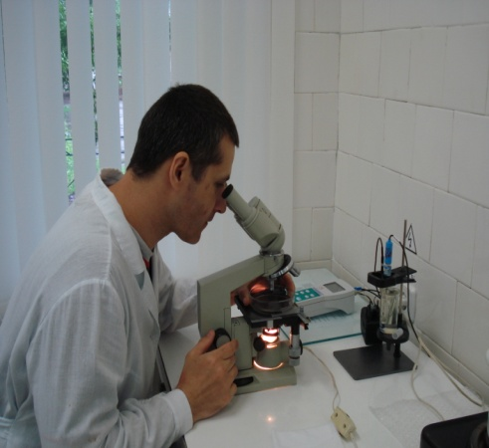
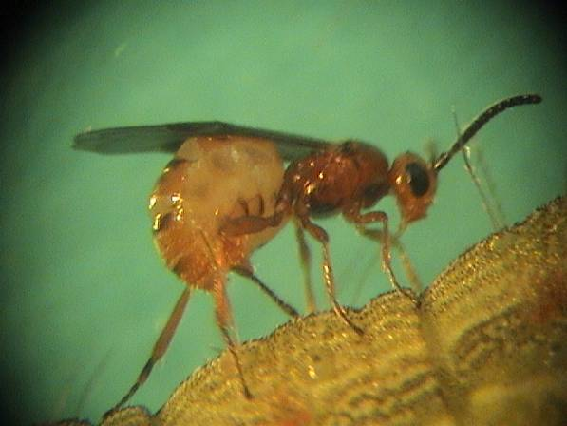
Laboratory method for biological pest control, plant diseases and weeds
The main task of laboratories is production of biological method in plant protection, monitoring for their implementation, quality control of biologicals, which are received in agriculture, organization and propaganda of achievements in science on minimal pesticide usage.
The laboratory has two shops: 1. Shop on baktorodentsyd production; 2. Shop on Trichogramma reproduction.

Slide 14
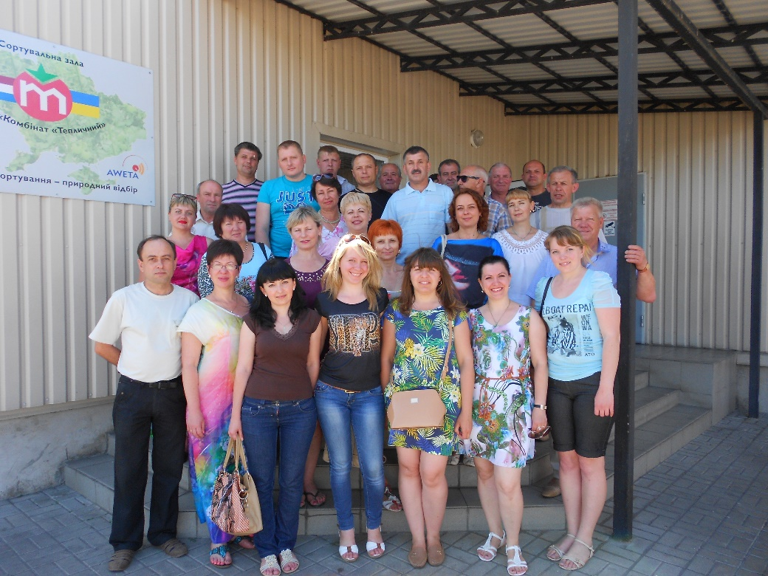
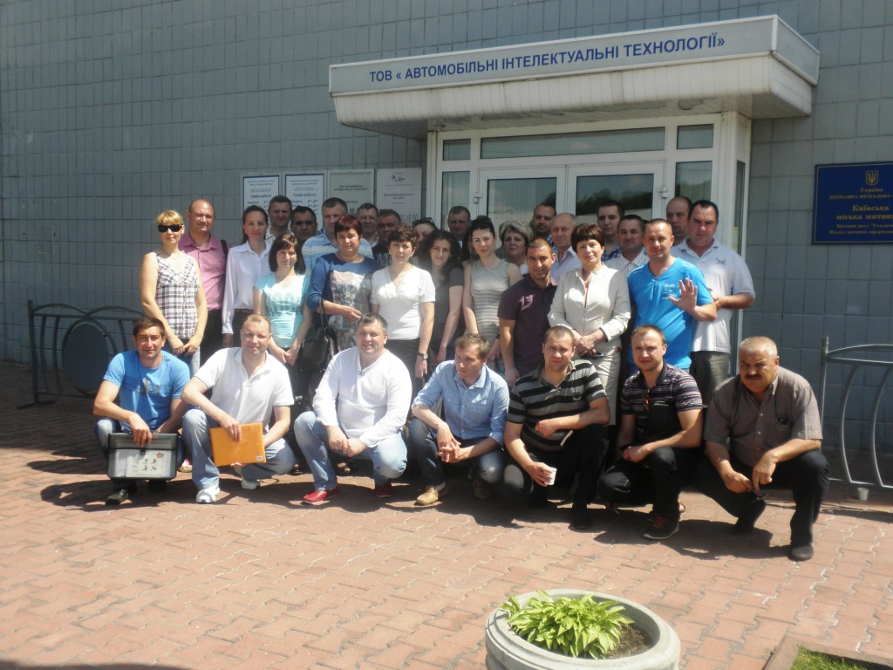
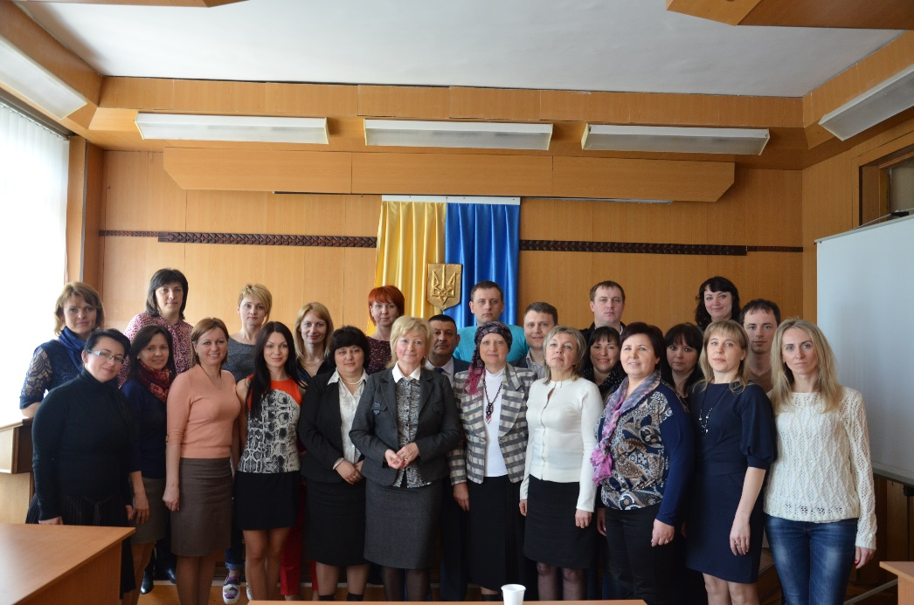
Extension courses for the phytosanitary inspectors and specialists of the phytosanitary laboratories

Slide 15
Our contacts:
State Service of Ukraine on Food Safety and Consumer Protection The Department of Phytosanitary Security, Control in Seed Production and Seedling
7, Koloskova str., Kyiv, 03138 Ukraine
Phone: (38044)524-77-07
Fax: (38044)524-89-02
Email: phyto@consumer.gov.ua
Website: www.consumer.gov.ua

